Slide 1
CDIB: THE ROLE OF THE CERTIFICATE OF INDIAN BLOOD IN DEFINING NATIVE AMERICAN LEGAL IDENTITY
PAUL SPRUHAN
Arizona State University School of Law
October 30, 2018

Slide 2
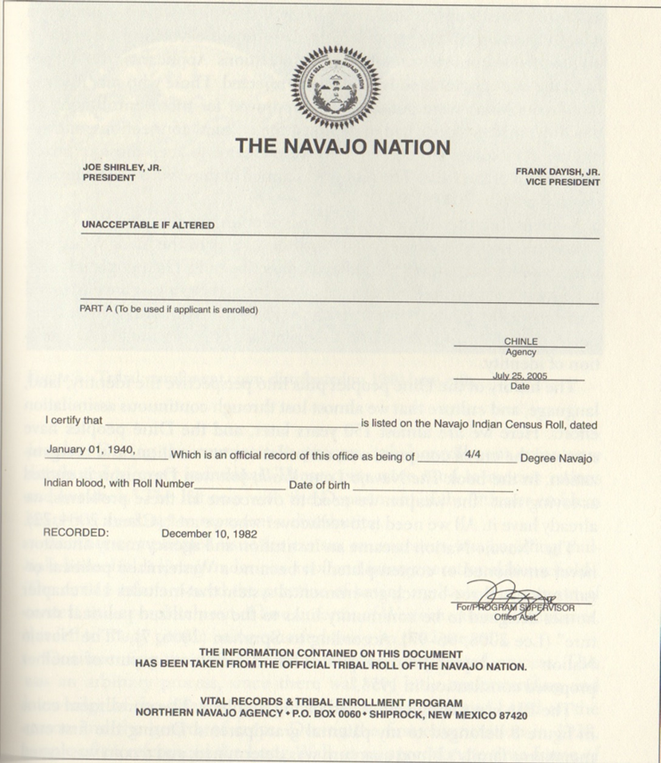
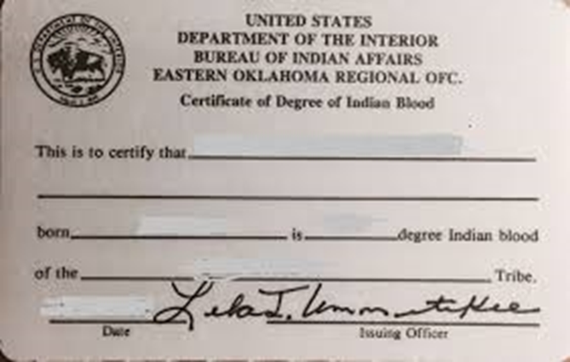

Slide 3
STATUTES AND REGULATIONS USING ONLY BLOOD QUANTUM
Indian Reorganization Act (1/2 blood)
Loan Provisions (1/4 blood)
Alaska Native Claims Settlement Act (1/4 blood)
Stigler Act- allotments of Five Civilized Tribes (1/2 blood)
Marine Mammals Protection Act Reg. (1/4 blood)
Johnson O’Malley funding Reg. (1/4 blood) (proposed rule to eliminate blood quantum requirement)

Slide 4
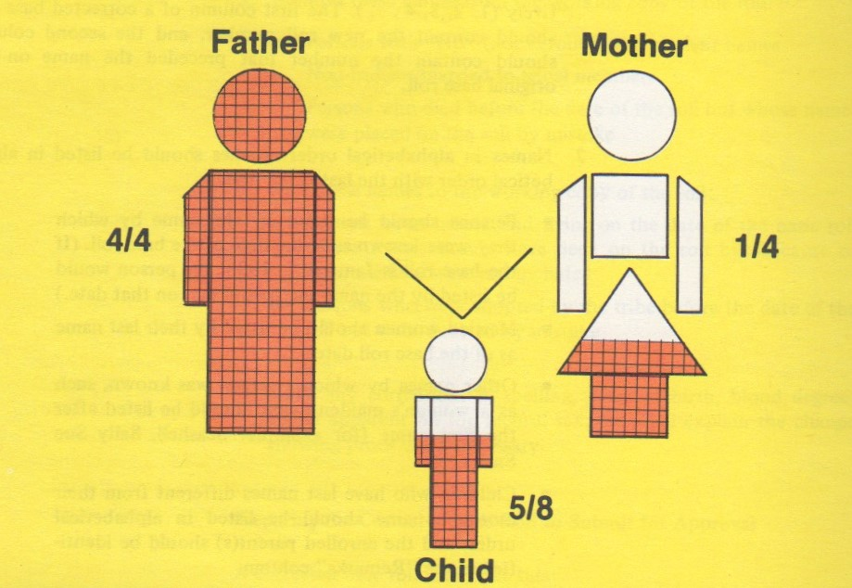

Slide 5
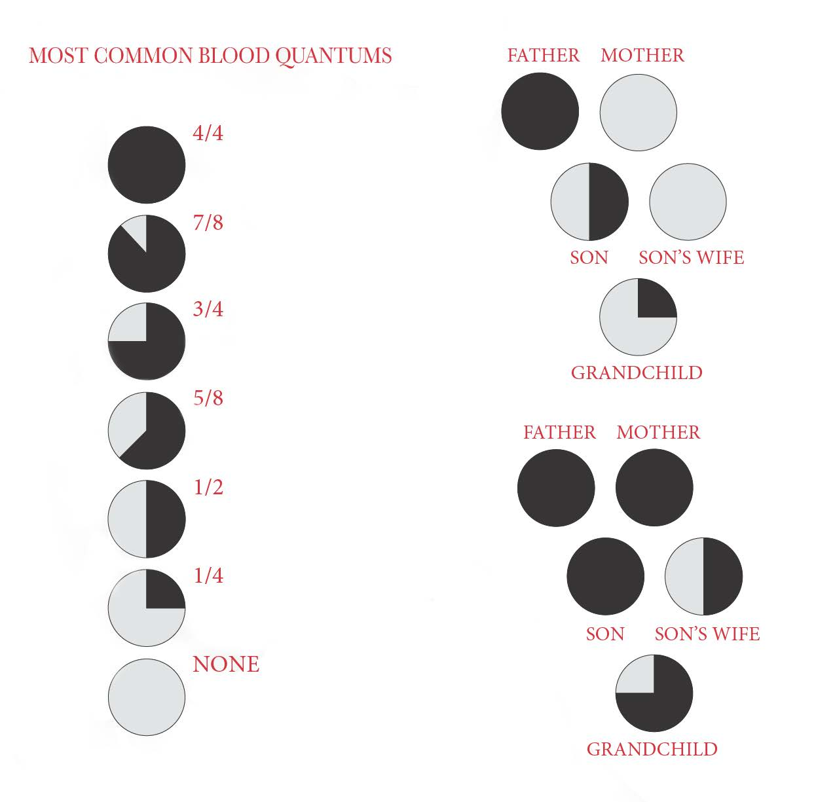

Slide 6
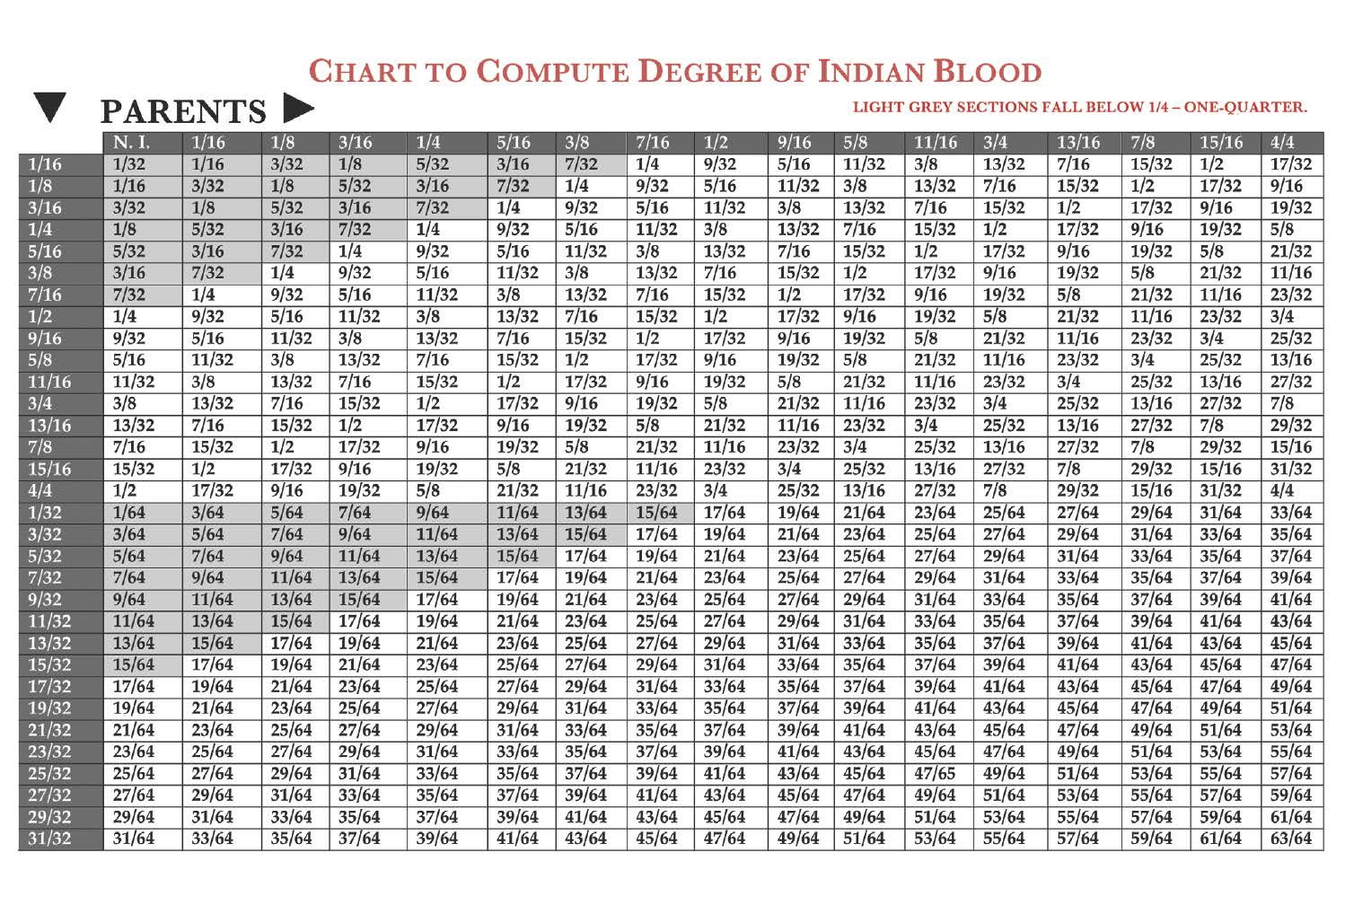

Slide 7
PRE-AMERICAN ORIGINS OF BLOOD QUANTUM
“Limpieza de sangre” : Purity of blood originating in Spain during inquisition
Originally applied to Jewish and Muslim converts
Adapted to New World in Mexico for Indian ancestry
“Half” and “Whole” blood: Defined rights of inheritance for relatives under English property law

Slide 8
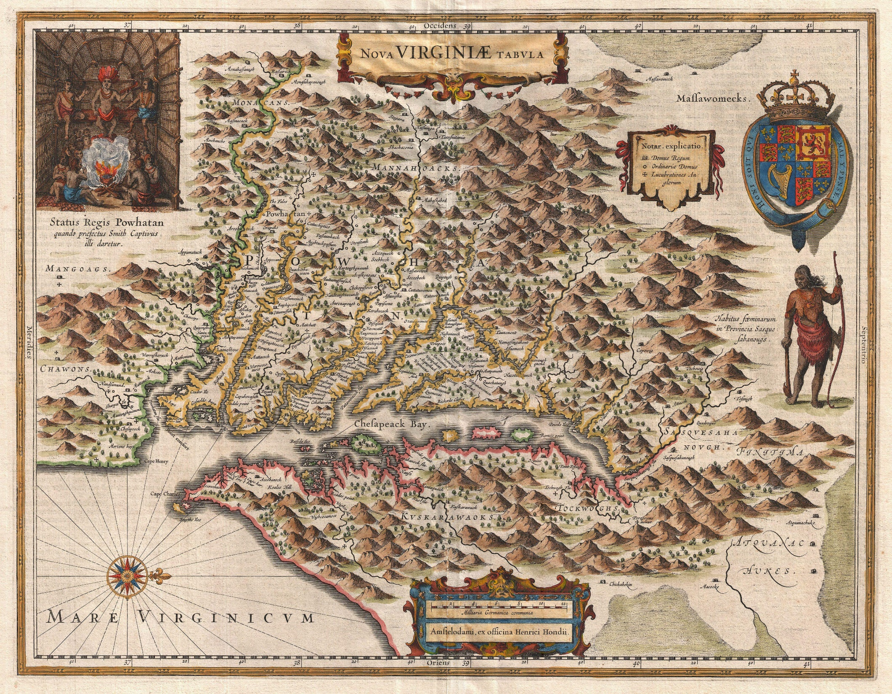
VIRGINIA STATUTES
Definitions of “Mulatto”
1705:
“the child of an Indian and child, grandchild or great grandchild of a negro”
1785:
[E]very person of whose grandfathers or grandmothers any one is or shall have been a Negro, although all his other progenitors, except that descending from the Negro shall have been white persons . . . and so every person who shall have one-fourth or more Negro blood, shall, in like manner be deemed a mulatto

Slide 9
Inhabitants of Andover v. Inhabitants of Canton (Mass. 1816)
It [was] immaterial, whether she was a mulatto or not, provided she associated with the tribe, making one of their number.

Slide 10
Wall v. Williams (Ala. 1847)
In common parlance, the word “Indians,” includes not only those who have no admixture of blood with the white or negro races, but those descendants of Indians who have become thus mixed, yet retain their distinctive character as members of the tribe from which they trace their descent.

Slide 11
REFERENCES TO BLOOD QUANTUM IN TREATIES
1817:
Treaty with the Wyandot (first reference to mixed-blood individuals)
1824:
Treaties with Sac and Fox and Sioux, et al. (Separate reservations granted to “half breeds”)
1837:
Treaties with Sioux and Winnebago (Monetary payments to individuals “not less than one quarter Indian blood”)

Slide 12
Treaties Recognizing Mixed-Bloods as Tribal Members
Treaty with the Omaha (1865)
Treaty with the Winnebago (1859)
Treaty with the Ponca (1858)
Treaty with the Pawnee (1857)
Treaty with the Chippewa (1847)

Slide 13
FEDERAL JUDICIAL DEFINITIONS OF “INDIAN”
“Race”- U.S. v. Rogers, 45 U.S. 567 (1846)
Partus Sequitur Ventrem (status follows the mother)- U.S. v. Sanders, 27 F. Cas. 950 (1847)
Partus Sequitur Patrem (status follows the father)- Ex Parte Reynolds, 27 F. Cas. 582 (1879)

Slide 14
ALLOTMENT ELIGIBILITY
Different types of allotments
On-Reservation- Instructions from BIA to include all tribal members, including, in some cases, intermarried white men (1868 Sioux Treaty)
Five Civilized Tribes- included Whites, Freedmen (blood quantum recorded for Indians by blood)
Public Domain- Went from partus sequitur Patrem to tribal membership (Black Tomahawk v. Waldron (1893-98); Waldron v. United States (1907))

Slide 15
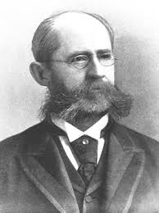
BIA VIEWS
Commissioner Thomas Morgan
There is no doubt that there is a stage at which, by the admixture of white blood and non-affiliation with the Indian tribes, persons would be debarred from participating in tribal benefits. The admixture of blood, however, must be considered in connection with all the circumstances of each case; consequently, a fixed rule equally applicable to all cases can not be well adopted

Slide 16
1897 Marriage Statute
All children born of a marriage heretofore solemnized between a white man and an Indian woman by blood . . . where said Indian woman is at this time, or was at the time of her death, recognized by the tribe shall have the same rights and privileges to the property of the tribe to which the mother belonged

Slide 17
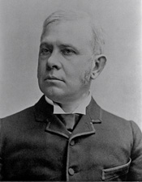
Senator Anthony Higgins (1895)
This nation is generous, and means to be generous, to the Indians, but by that, I know, the people understand and mean the Indian aborigines, not the half-bloods, not the quarter-bloods, not the eighth-bloods, not those in whom you can not observe the physical admixture
. . . this is growing to be a vast abuse.

Slide 18
It seems to me one of the ways of getting rid of the Indian question is just this of intermarriage, and the gradual fading out of the Indian blood; the whole quality and character of the aborigine disappears, they lose all of the traditions of the race; there is no longer any occasion to maintain the tribal relations, and there is then every reason why they shall go and take their place as white people do everywhere

Slide 19
BLOOD QUANTUM IN RELEASE OF ALLOTMENT RESTRICTIONS
Five Civilized Tribes
1904:
“Indians who are not of Indian Blood”- No restrictions but their homestead
1908:
Less than ½ Indian blood- no restrictions
½ to less than ¾ Indian blood- No restrictions but their homestead
¾ or more Indian blood- All restrictions remain in place

Slide 20
OTHER ALLOTMENTS
White Earth Chippewa:
1906: Congress releases all “mixed bloods”
Other tribes:
1917: All Indians of less than ½ Indian blood freed from restrictions
1919: Indians of ½ Indian blood
Ended in 1921

Slide 21
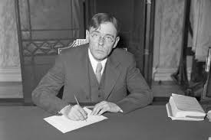
INDIAN REORGANIZATION ACT
1934:
Ends allotment of reservations
Authorizes tribal constitutions with membership provisions
Allows Secretary of Interior to acquire land and declare reservations

Slide 22
IRA DEFINITION OF “INDIAN”
Defines “Indian” for these purposes as:
1. All persons of Indian descent who are members of a recognized tribe
2. All Descendants of members living on a reservation
3. All others of ½ or more Indian blood

Slide 23
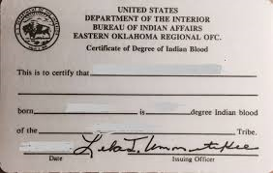
CREATION OF CDIB
No statute or regulation authorizing or controlling CDIBs
John Collier letters to Indians of Robeson County, NC stating they are ½ or more Indian blood under IRA
Late 1930s Memorandum from Commissioner stating a “certificate” could be used to show ¼ blood

Slide 24
Underwood v. Dep. Asst. Sec. 14 IBIA 3 (1986)
BIA unilaterally unilaterally changed Underwood’s blood quantum on his CDIB from 4/4 to 1/2
Alleged lack of adequate proof of paternity
IBIA rules CDIBs not discretionary so to avoid IBIA jurisdiction
IBIA invalidated the reduction of blood quantum no published regulations on CDIBs in violation of Administrative Procedures Act

Slide 25
2000 Draft Regulations
Allegedly required by Underwood to make changes to CDIBS (but 1987 rule stripping IBIA jurisdiction)
Paternity rule, even for earlier ancestors
Right to make unilateral changes or complete invalidation of CDIBs if “in the public interest”

Slide 26
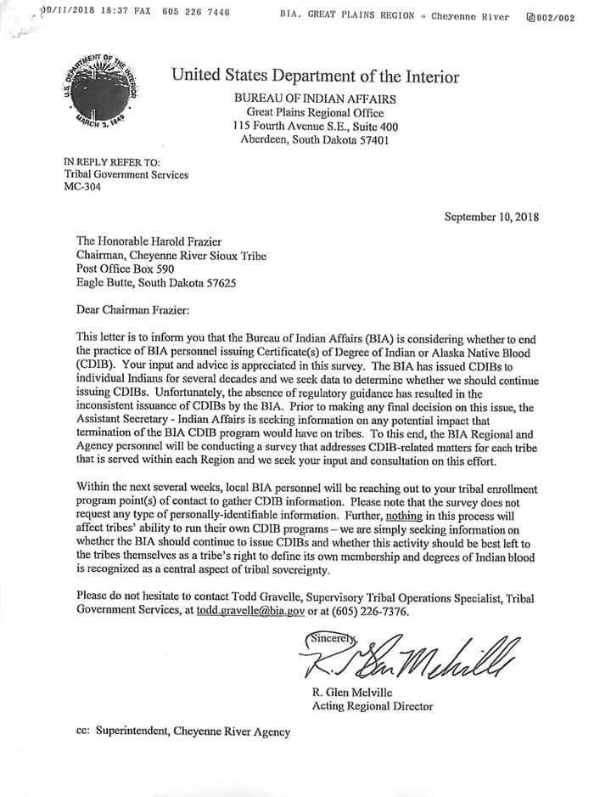

Slide 27
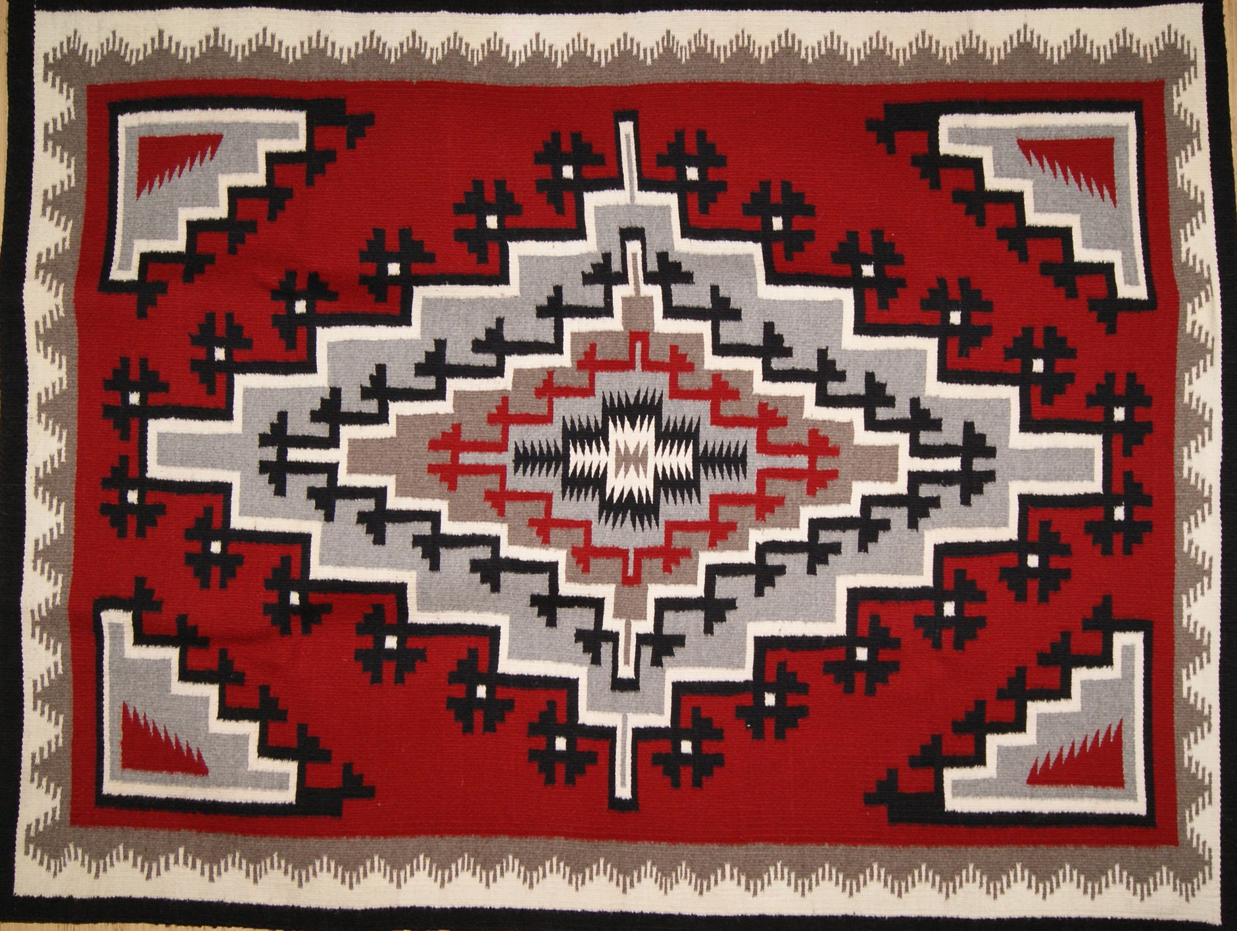
Thank you

