Slide 1
Navajo Nation
Legislative Research and Update

Slide 2
OFFICE OF LEGISLATIVE COUNSEL
Dana bobroff, Chief Legislative Counsel
Mariana Kahn, Senior Attorney
Ron Haven, Senior Attorney
Jennifer Skeet, Principal Attorney
Kristen Lowell, Principal Attorney

Slide 3
Office of Legislative Counsel
The purpose of the Office of Legislative Counsel is to provide legal advice, legal representation and legislative services to the Navajo Nation Council, standing committees, commissions, and boards of the Navajo Nation Council, offices and programs of the Legislative Branch of the Navajo Nation, independent of the Department of Justice. 2 N.N.C. § 961

Slide 4
Office of Legislative Counsel
Authorities, duties and responsibilities
To provide legal representation to the Navajo Nation Council, standing committees, commissions and boards of the Navajo Nation Council, offices and programs of the Legislative Branch, independent of the Department of Justice, through Office of Legislative Counsel and outside counsel contracted by the Office of Legislative Counsel, to represent the legal interests of the Legislative Branch of the Navajo Nation
2 N.N.C. § 964(A)(5)

Slide 5
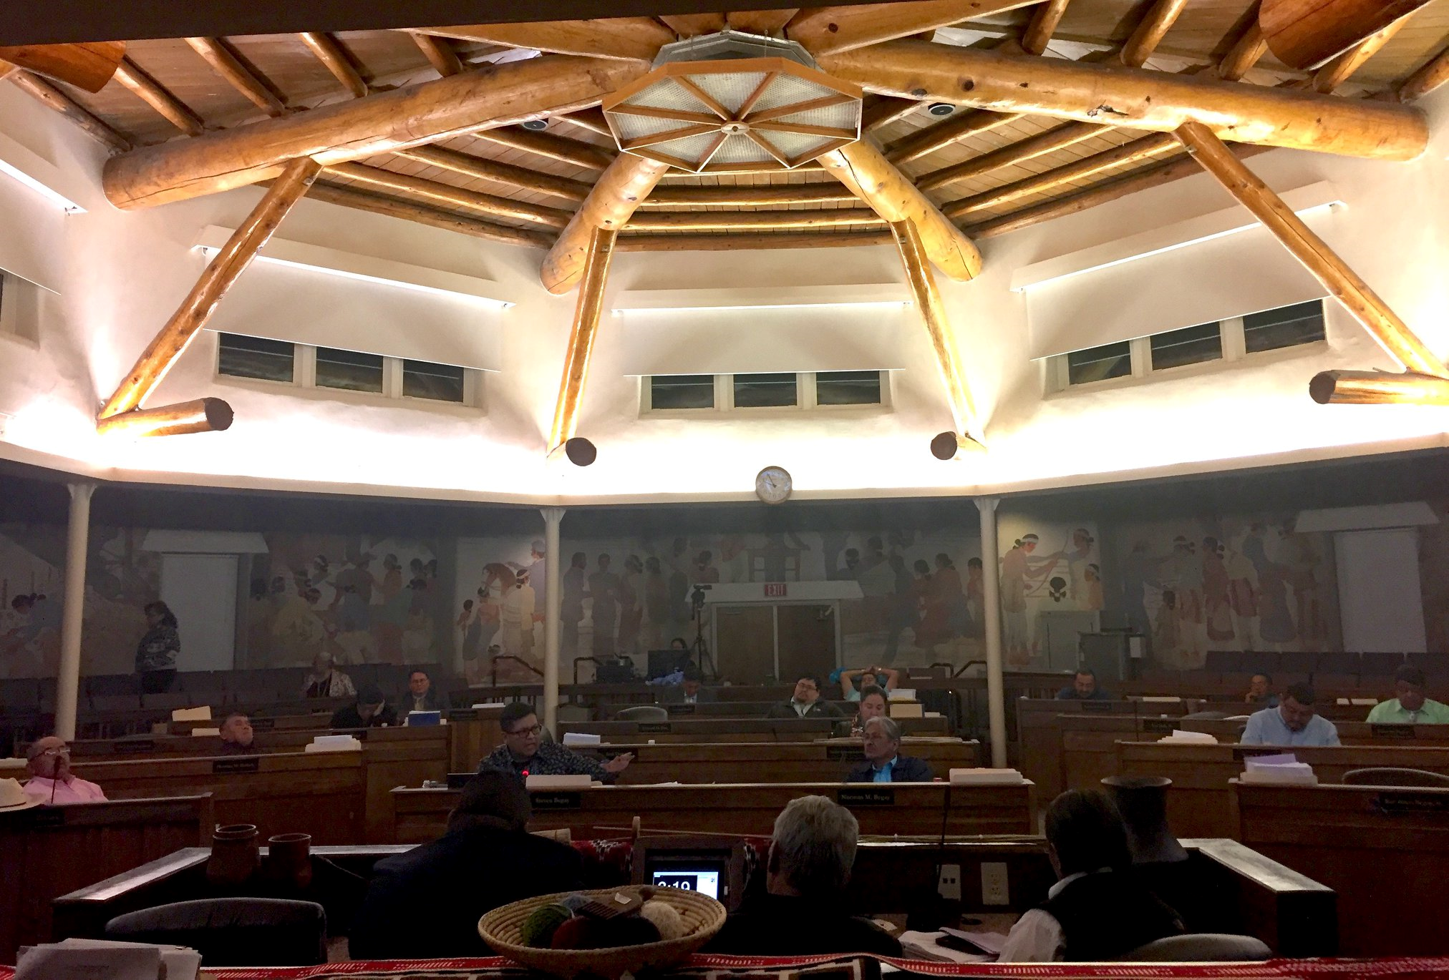
Five Standing Committees
Budget & Finance (BFC) 2 N.N.C. § 300 et seq.
Health, Education & Human Services (HEHS) 2 N.N.C. § 400 et seq.
Resources & Development (RDC) 2 N.N.C. § 500 et seq.
Law & Order (LOC) 2 N.N.C. § 600 et seq.
Naabik’íyáti’ (NABI) 2 N.N.C. § 700 et seq.

Slide 6
Legislative research
Supplement/pocketpart covers partial 2014 to partial 2017
Everything after 2017 available on DiBB
DiBB covers 2015 and after
Legislative Archives
2 N.N.C. § 88 (F), the Office of Legislative Services shall respond to public record request(s) P within the specified time frame of 90 days.
2 N.N.C. § 88 (H), reasonable costs may be assessed for photocopying and other duplicating activities.
For resolutions before 2014
Try to have resolution number
-Sometimes you can find an old resolution you want attached as an Exhibit or at least find the resolution number
Navajo Nation Records Management

Slide 7
Resolution Numbering system
Helpful Information:
CD-68-89
Resolutions
C = Council
D = December
68 = 68th resolution of the year
89 = year (1989)
Examples:
LOCJY-14-18
RDCJN-56-18
BFAU-34-18
HEHSCF-04-18
NABIS-50-18

Slide 8
Legislative Research

Slide 9
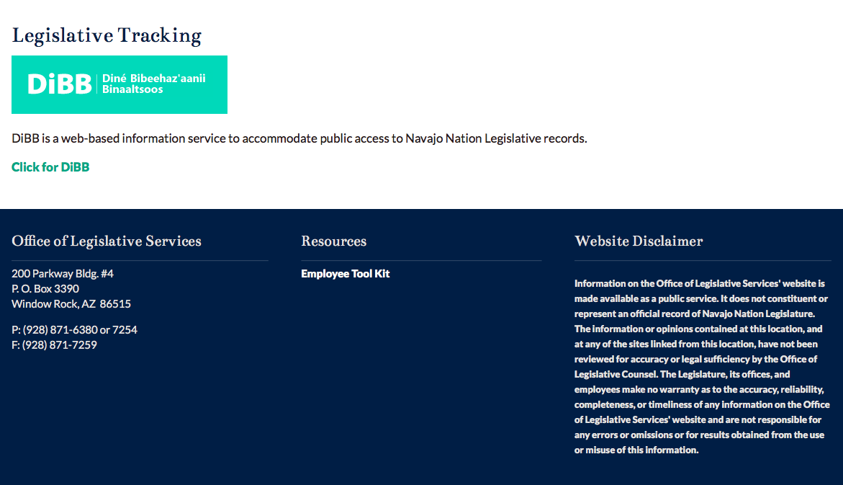
Legislative research

Slide 10
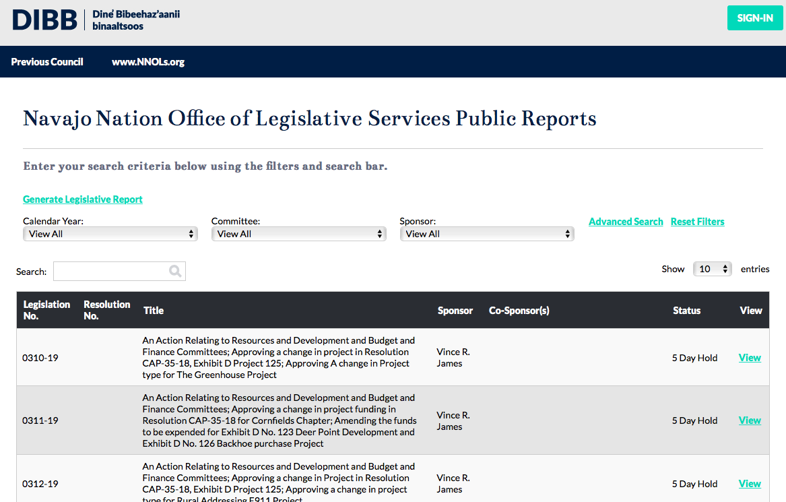
Legislative research

Slide 11
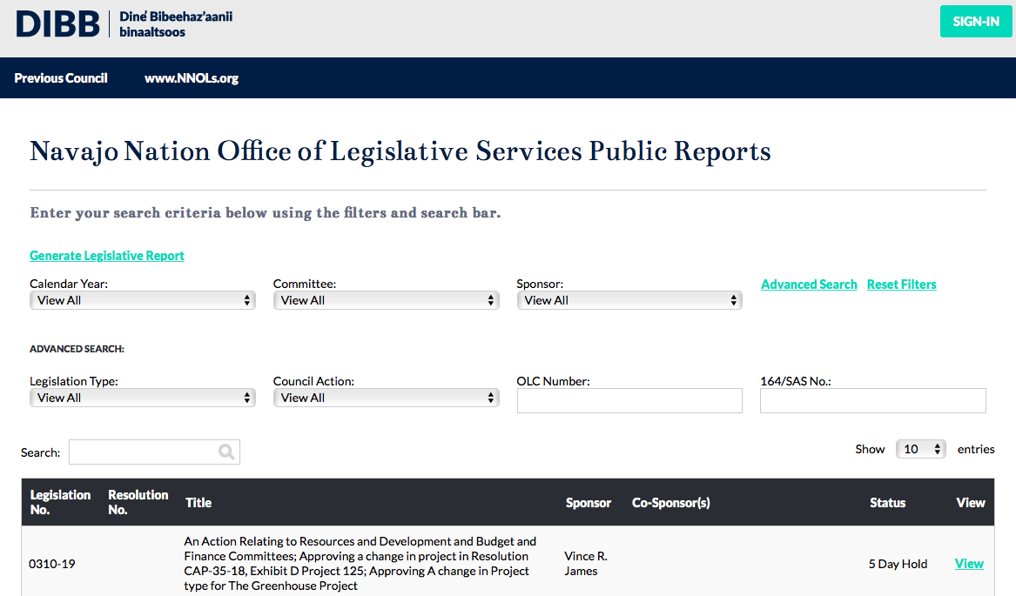
Legislative research

Slide 12
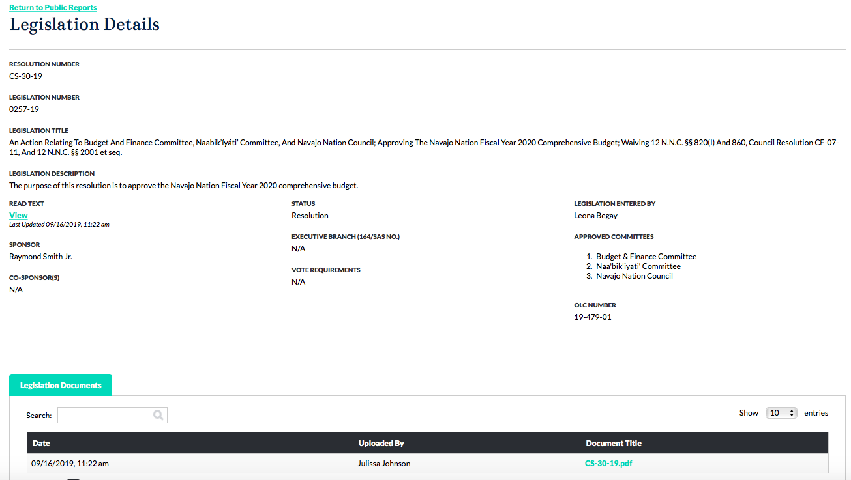
Legislative research

Slide 13
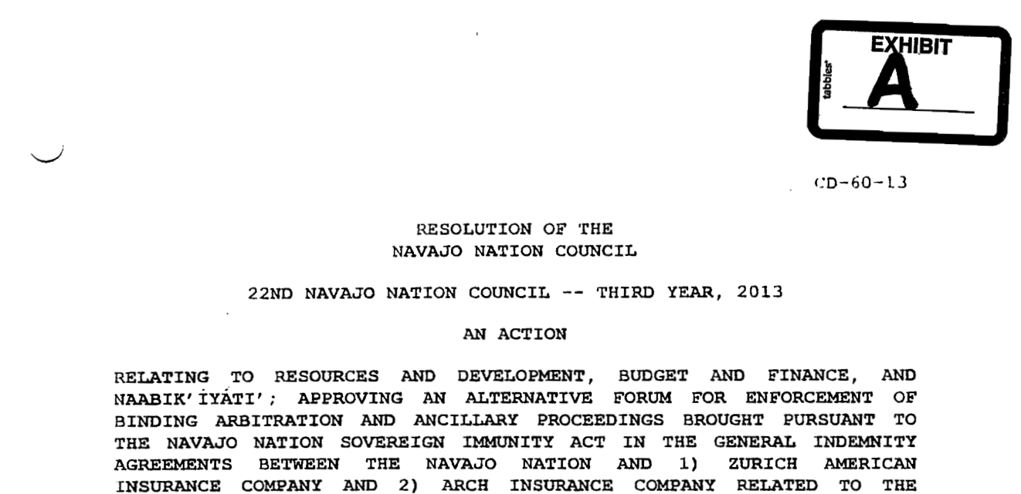
Legislative research
Notes:
CAP-13-15 which amended CD-60-13

Slide 14
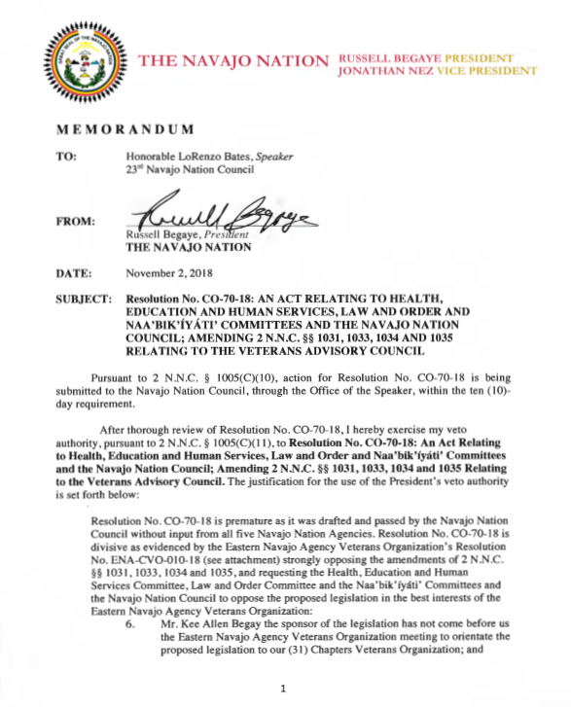
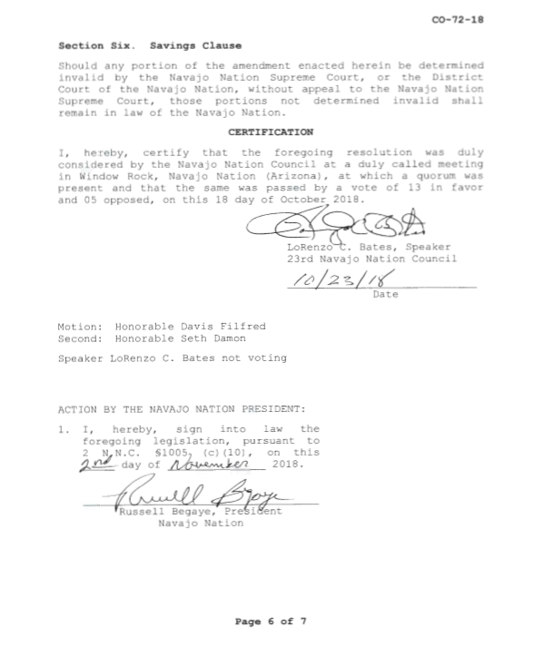
ALWAYS OPEN and CHECK THE RESOLUTION

Slide 15
Major Steps
Initiating / Drafting legislation
Office of Legislative Services legislation intake and review
Office of the Speaker review
Initiate legislation public comment (on DiBB)
Digital distribution of legislation
Public comment review (OLS Director)
Standing Committee referral(s)
Navajo Nation Council referral
On the floor
Amendments, tabling motions, votes, etc
If passes, depending on authority, Speaker or President signs resolution
NABIMA-16-17

Slide 16
Tips to push your legislation along
Work with the sponsoring Delegate
Do your homework and provide all necessary documents for the specific type of legislation i.e. UUFB, Sihasin Funds, CLUP, ROW, etc.
Reviews
Budget forms
Chapter house resolution(s)
Other helpful information
Start early
If there is a deadline-let the Delegate and OLC know
Call Office of Legislative Counsel (and be nice)
Be ready for questions at Committee or Council
Track your legislation using DiBB

Slide 17
Navajo Nation Initiative
88 Delegates to 24 Delegates
CAP-10-11
Reflects changes from 88 to 24 including reduction in standing committees and modifies legislative process to include public comment and emergency legislation
CO-45-12:
Reflects reduction to 24 and revised quorum and committee directives

Slide 18
Select Standing Committee Resolutions
SELECT STANDING COMMITTEE RESOLUTIONS – by statute, Standing Committees have final authority over certain matters.
RDCD-104-18: An Action Relating to Resources and Development Committee; Amending the Navajo Nation Ranches Grazing Fee from $4.00 per animal unit per month to $8.00 per animal unit per month
LOCS-19-18
An Action Relating to Law and Order Committee; Approving Rules and Regulations Governing Delegation of Authority from the Law and Order Committee to the Judicial Conduct Commission on the Screening of Applicants and Recommendations for Probationary Appointment of Judges and Justices; Approving Delegation of Authority as set forth at 2 N.N.C. §§ 601 (B)(7) and (B)(&)(a); Amending the Plan of Operation for the Judicial Conduct Commission

Slide 19
Code AMENDMENTS Oct 2018 to present

Slide 20
CO-71-18 An Action Relating to Resources and Development, Law and Order and Naabik'iyati' Committees and the Navajo Nation Council; Authorizing the Kayenta Township Commission ("KTC") to Form Wholly Owned Entities of the Kayenta Township under Navajo Law, Including for Participation in the U.S. Small Business Administration 8(a) Business Development Program; Extending the Navajo Nation's Privileges and Immunities (Including their Sovereign Immunity) Upon a Finding such Waiver would be in the Best Interest of the Township and Upon Prior Notice to the President of the Navajo Nation and the Speaker of the Navajo Nation Council; Amending 1 N.N.C. § 552(O) of the Navajo Sovereign Immunity Act and 2 N.N.C. §§ 4084 And 4085 of the Kayenta Township Home Rule Statute
CO-72-18 An Act Relating to Resources and Development and Naabik'iyati' Committees, and the Navajo Nation Council; Amending 5 N.N.C. § 1707, Navajo Nation Gaming Enterprise Board Composition, qualification and confirmation
CO-73-18 An Action relating to Budget and Finance, Law and Order, Naabik’íyáti’ Committees and the Navajo Nation Council; Amending 12 N.N.C. § 203, Duties, Responsibilities and Authority of the Controller

Slide 21
CO-74-18 An Action Relating to Law and Order Committee, Budget and Finance Committee, Naabik'iyati' Committee and the Navajo Nation Council; Amending CJA-07-18, Amending 24 N.N.C. § 620 of the Navajo Nation Sales Tax to the Navajo Nation Fire and Rescue Services; Amending the effective date
CO-75-18 An Act Relating to Health, Education and Human Services, Resources and Development, Law and Order and Naabik'iyati' Committees and the Navajo Nation Council; Enacting the "Controlled Substance Definition Act of 2018"; amending Title 17 Chapter 3, Controlled Substances at 17 N.N.C. §§ 390, 394
CO-76-18 An Act Relating to Law and Order, Resources and Development, Naabik'iyati' Committees; Adopting "The Navajo Gaming Ordinance Amendment Act of 2018" Amending 5 N.N.C. §2001 Et. Seq., Navajo Gaming Ordinance
*CN-79-18 An Action Relating to Law and Order, Naabik'iyati' and the Navajo Nation Council; Amending the Navajo Nation Election Code at 11 N.N.C. §241(A) to lower percentage of signatures requirement on recall petitions from 60 to 30% of voters voting in last election for position in question

Slide 22
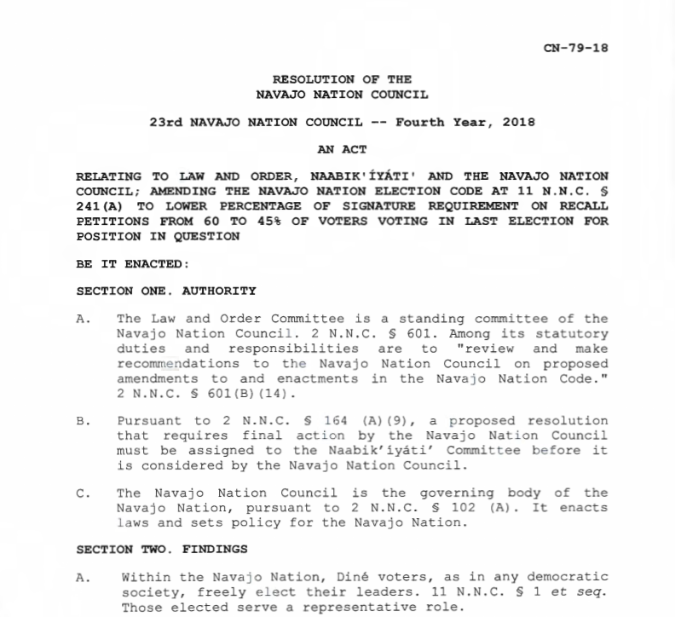
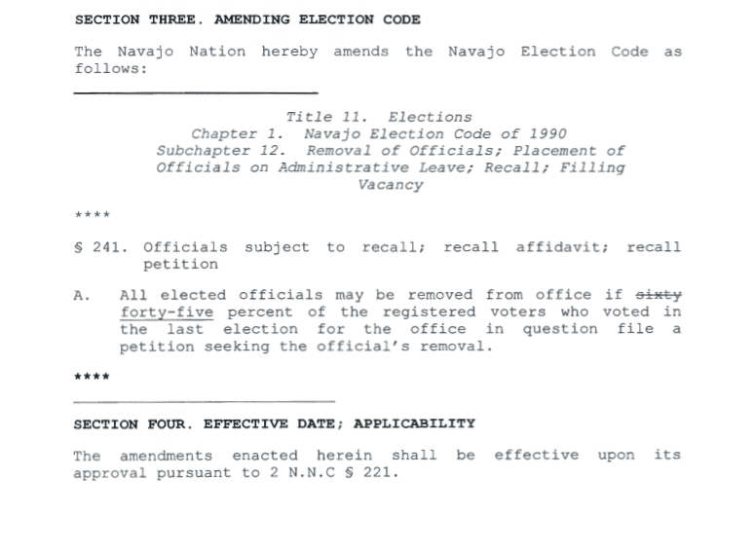
ALWAYS CHECK THE RESOLUTION!

Slide 23
CD-81-18 An Act Relating to Law and Order, Naabik’íyáti’ and the Navajo Nation Council; Amending 2 N.N.C. § 1352 and 17 N.N.C. §§ 1851 Through 1854; Amending Coroner Provisions and Establishing a Department of Medical Examiners within the Division of Public Safety; Authorizing the Law and Order Committee to Approve a Plan of Operation for the Department of Medical Examiners
CD-87-18 An Action Relating to Law and Order, Naabik'iyati' and Navajo Nation Council; Amending Challenge and Election Dispute provisions of the Navajo Nation Election Code at 11 N.N.C. §§ 21, 23, 24, 240, 341 and 342

Slide 24
CJY-25-19 An Act Relating To Law And Order, Health, Education And Human Services, And Naabik’íyáti’ Committees, And The Navajo Nation Council; Amending 2 N.N.C. § 403, Meeting Day For The Health, Education And Human Services Committee

Slide 25
Navajo Nation Council Fall Session 2019

Slide 26
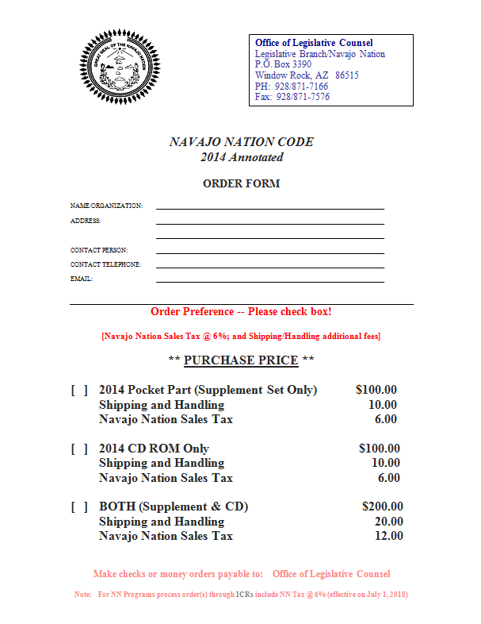

Slide 27
OFFICE OF LEGISLATIVE COUNSEL
PO Box 3390
Window Rock, AZ 86515
928-871-7166
www.navajonationcouncil.org

