Slide 1
Criminal Law: Nuts & Bolts
Aka: criminal defense for attorneys who purposely chose not to practice criminal law

Slide 2
Jennifer Henry
Acting Chief Prosecutor
Navajo Office of the Prosecutor
Phone: 505-755-3238 | Fax: 505-775-3566 (Ramah)
Phone: 928-871-6622 | Fax: 928-871-6633 (WR)
Work cell (24/7, sadly): 928-206-7482
jahenry@navajo-nsn.gov

Slide 3
Omg I just got a criminal appointment!
Stare at envelope in disbelief and fear
Check and double-check the court order
Break out into a sweat
Consider calling your professional liability insurance provider
Think of ways you can get out of the appointment
I’m too busy and/or I work very far away.
This is going to be very burdensome for me/my firm.
I’m not competent to represent a criminal defendant.
Can I sell or trade this appointment?

Slide 4
Remember your oath(s)?
Think back. Take a deep breath. You can do this.

Slide 5
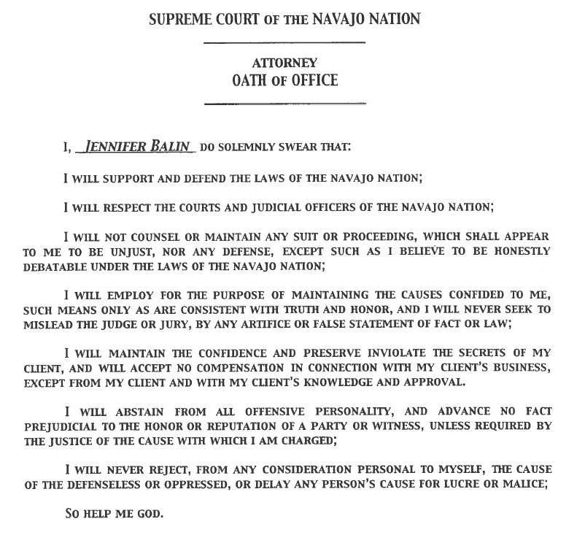

Slide 6
Pull yourself together
Review the documents your received – make sure you have the entire case file
If you don’t, call the Court and get all the pleadings.
Find your Title 17 (or 14)
Find your Rules of Criminal Procedure and Evidence
Find your Navajo Bill of Rights

Slide 7
Navajo Criminal law Where is it?
1 N.N.C. §§1-9: Navajo Bill of Rights
Title 17: Navajo Nation Criminal Code
Title 14: Motor Vehicle Code
Especially: §§700-724
Navajo Rules of Criminal Procedure
Navajo Nation Supreme Court opinions
Diné bi beehaz’aanii

Slide 8
Navajo Criminal law Where is it?
Criminal offenses in Title 14 have not been amended since 1988
Title 17 (a little more problematic)
Code Books/Website current through 2009

Slide 9
Title 17 updates since 2009
Extradition and Detainer Act (CJY-29-13)
Violence Against Family Act (CJA-04-12)
Sex Offender Registration and Notification Act
Amendments: CJA-11-16, CJY-38-16
Sentencing Provisions Amendment (CN-52-14)
Navajo Nation Law against Human Trafficking (CJY-48-17)
Cyberbullying Act," CJA-09-18
"Revenge Porn Act," CAP-43-18
White Collar Crime Amendments,” CO-59-17
Sentencing Provisions Amendment CN-52-14Controlled Substance Definition Act of 2018," CO-75-18

Slide 10
Navajo Supreme Court Opinions
List of Navajo Nation criminal case law included in course materials posted online. Want a copy by email – let me know.
If you’d like a copy of anything we talk about today, let me know.
Research tip: Navajo Nation does not have the right to appeal in criminal cases, so if you’re looking for case law it will likely be from writs or defense appeals.

Slide 11
On to the “nuts and bolts”
You can delay no longer

Slide 12
First things first
Do a conflict check on client
Do a conflict check on witnesses and victims
Determine date of next hearing
Contact your client!

Slide 13
Criminal timeline
Prosecutor files complaint(s)
ARRAIGNMENT
(discovery)
PRETRIAL CONFERENCE(S)
(more discovery; pretrial motions)
TRIAL
SENTENCING
POST-TRIAL WORK

Slide 15
Where is the case at when you’re appointed?
ALMOST ALWAYS AFTER ARRAIGNMENT
is your client in custody? If so – GO TO THE JAIL NOW
review the arraignment order
should you make a jury demand?
make a request for discovery

Slide 16
REVIEW THE COMPLAINT
No joinder of offenses (Rule 7)
No joinder of defendants (Rule 7)
Check content of complaint (Rule 8)
Client’s name (or description that IDs w/ reasonable clarity)
Client’s census #, if any
Client’s address
Essential facts, including jurisdictional facts
Statutory name of offense
Section of Code allegedly violated
No unnecessary allegations

Slide 17
Review the summons & service
Was your client served by a Navajo Nation Police officer?
Was your client served within the territorial jurisdiction of the Navajo Nation?
Was the summons and complaint handed directly to your client?

Slide 18
IS THERE A JURISDICTION ISSUE?
SERVICE OF PROCESS SUFFICIENT?
LOCATION OF ALLEGED OFFENSE?
CLIENT’S TRIBAL AFFILIATION?

Slide 19
CLIENT CONTACT & COMMUNICATION
When to contact your client?
In custody – immediately! (Not ASAP. Immediately.)
Not in custody
Are you guilty? Did you do it? Client admissions.
Authority to talk to client’s family.
Go through criminal process and hearings.
Give your client the discovery.
Get your client’s contact information!
Make the next appointment.
Keep your promises to your client.

Slide 20
Let’s talk about bail
This and discovery are big issues

Slide 21
bail
17 N.N.C. §1807
“Every person arrested for an alleged offense against the Navajo Nation shall, within a period of 18 hours from the time of commitment, be given an opportunity to be released on bail.”

Slide 22
So who offers/decides bail?
Judges &/or the Detention Facility
Specific bail for each alleged offense(not to exceed maximum fine)
Bail schedule for various offenses (majority of judges w/ Chief Justice’s concurrence)
Police officers authorized by the Director of the Department of Law Enforcement could implement the schedule
Department of Corrections could implement the schedule
17 N.N.C. §1815 Director of the Department of Law Enforcement is authorized and directed to authorize officers to admit persons to bail when Court is not in session
17 N.N.C. §1815 Director of the Department of Law Enforcement is directed to assure that an officer authorized to admit persons to bail be on duty at each jail facility during said times
“Consent decree” (1992) and Navajo Nation v. Holmes (2013)

Slide 23
BAIL/RELEASE
17 N.N.C. §1805
“No person shall be detained, jailed or imprisoned under any law of the Navajo Nation for a longer period than 36 hours, unless there be issued a commitment bearing the signature of a duly qualified judge of the Court of the Navajo Nation….”

Slide 24
HOLIDAYS AND WEEKENDS
Certain things just seem more likely to happen on holidays and weekends:
Kids get sick when the clinic’s closed
Dogs need medical help when the vet is closed
Your clients will be arrested when the court’s closed

Slide 25
Nizhoni
Easter weekend, 2005

Slide 26
Shylah
SUNDAY EVENING, December 6, 2015

Slide 27
BAIL/RELEASE (Friday, weekends, holidays)
17 N.N.C. §1805
“…however, that a person arrested on a Friday, Saturday, Sunday, or a day before a holiday, who, having been given an opportunity within 36 hours after arrest to be released on bail does not provide bail, may be held in custody pending commitment for a reasonable additional period not to exceed eight hours following the opening of court on the next day it is in session.”

Slide 28
Should you file a writ?
And/or should you call the prosecutor?

Slide 29
BAIL/RELEASE
“…there is a legal presumption for release by personal recognizance unless the Navajo Nation objects and a judge makes ‘certain findings’ to the contrary at the defendant’s initial appearance.”
Wood v. Window Rock Dist. Ct.
slip op. No. SC-CV-20-29
(Nav. Sup. Ct. July 1, 2009)

Slide 30
BAIL/RELEASE
“Certain findings”
The court has reason to believe:
Defendant is dangerous to public safety (Rule 15(d))
Defendant will commit a serious crime (Rule 15(d))
Defendant will seek to intimidate any witness (Rule 15(d))
Defendant will otherwise unlawfully interfere with the administration of justice (Rule 15(d))
“For any other reason allowed by law” (Rule 15(d))
Defendant is unable to care for his or her personal safety (17 N.N.C. §1812)
Defendant will pose a danger to any other person (17 N.N.C. §1812)
Defendant will leave the lands subject to the jurisdiction of the Navajo Nation and fail to appear (17 N.N.C. §1812)

Slide 31
BAIL/RELEASE
Rule 15(b) & 17 N.N.C. §1812 findings
Must be made by CLEAR AND CONVINCING evidence

Slide 32
One more “certain finding” 17 N.N.C. §1812(A)(4)
“When the person charged has allegedly done or committed acts as part of the same design or transaction upon which the alleged offense against the Navajo Nation is charged which would in the officer’s or the judge’s belief constitute a felonious offense, which shall be for the purposes of this Section, an offense under 18 U.S.C. §1153.”

Slide 33
Major Crimes act 18 U.S.C. §1153
Any Indian who commits against the person or property of another Indian or other person:
Murder
Manslaughter
Kidnapping
Maiming
Felony under chapter 109A (Sexual Abuse)
Incest
Assault w/ intent to commit murder
Assault w/ a dangerous weapon
Assault resulting in serious bodily injury
Assault against someone under 16 years old
Felony child abuse or neglect
Arson
Burglary
Robbery
Felony under section 661 in Indian Country (Embezzlement/Thefts)

Slide 34
Egregiousness of alleged offense NOT SUFFICIENT
“…mere seriousness of the alleged offense does not, by itself, justify continued detention.”
“To hold a defendant merely because the complaint alleges a serious offense improperly treats the defendant as guilty before the trial, by assuming the allegations are true and essentially punishing him or her before the Nation has established beyond a reasonable doubt that the offense occurred. This clearly violated Seaton’s right to due process.”
Seaton v. Greyeyes

Slide 35
Clear as mud?
Your client must be offered bail
Bail Agreement – third party release (17 N.N.C. §1808)
Cash bond (17 N.N.C. §1809)
Prosecutor must request denial of bail and findings must be made by clear and convincing evidence
Motion to deny bail (written or verbal at arraignment or bail hearing)
“Certain findings” by clear and convincing evidence to deny bail
Most writs are filed because of bail/release issues

Slide 36
ARRAIGNMENT - purpose
Rule 12
To bring the defendant before the Court
To advise the defendant of the specific nature of the charges against him or her
To advise the defendant of his rights under the law
To ask the defendant to enter a plea
NOT GUILTY
GUILTY
NO CONTEST

Slide 37
Arraignment - procedure
English(for the record); Navajo (if necessary)
Defendant is given a copy of the complaint
Case name and number is called
Defendant stands and faces the Bench
Court asks Defendant’s name, DOB, tribal membership, C#, and SS#
Court reads complaint to defendant and asks if defendant understands
Judge informs Defendant of rights
Judge informs Defendant of maximum penalty if found guilty or pleads guilty
Defendant enters a plea

Slide 38
Pleas
Pleas must be knowingly, voluntarily and intelligently made.
Some judges routinely enter not guilty pleas for Defendants
Some judges accept a guilty plea very (too?) easily
Some judges colloquy well with Defendants
Some judges … don’t
TALK TO YOUR CLIENT ABOUT ARRAIGNMENT/PLEA
REVIEW THE ARRAIGNMENT ORDER
MAKE SURE YOUR CLIENT UNDERSTANDS HIS/HER RELEASE CONDITIONS

Slide 39
DISCOVERY
(Rules 24-28)

Slide 40
Disclosure by the Navajo nation
AT THE TIME OF ARRAIGNMENT
GIVE TO DEFENDANT List of witnesses with their addresses which Navajo Nation intends to use against Defendant
“No other witnesses shall be allowed to testify against him except on notice to the defendant and with permission of the court.” Rule 25(a)

Slide 41
Disclosure by the navajo nation
NO LATER THAN 10 DAYS AFTER ARRAIGNMENT
MAKE AVAILABLE TO THE DEFENDANT FOR EXAMINATION AND REPRODUCTION THE FOLLOWING MATERIAL AND INFORMATION WITHIN THE PROSECUTION’S POSSESSION OR CONTROL:
(Rule 25(b))

Slide 42
Disclosure by the navajo nation
NO LATER THAN 10 DAYS AFTER ARRAIGNMENT
All statements of the defendant
Names and addresses of any experts who have examined the defendant or any evidence in the case; results of physical examinations or tests; written reports or statements made by those experts
List of all papers, documents, photographs or tangible objects which Prosecutor intends to use or which were obtained from or purportedly belonged to the defendant

Slide 43
Disclosure by the navajo nation
NO LATER THAN 10 DAYS AFTER ARRAIGNMENT
A list of all prior convictions of the defendant which Prosecutor will use at trial
A list of all prior acts of the defendant which Prosecutor intends to use to prove motive, intent, knowledge or otherwise use at trial
All material or information, which tends to mitigate or negate the defendant’s guilt as to the offense charged, or which would tend to reduce his punishment thereof, including all prior convictions of witnesses whom the prosecutor expects to call at trial

Slide 44
More disclosure by the navajo nation
WITHIN 10 DAYS AFTER ARRAIGNMENT
Rule 25(c) POSSIBLE COLLATERAL ISSUES
MAKE AVAILABLE TO DEFENDANT information as to whether:
there was any electronic surveillance of the defendant, or defendant’s business/residence
Whether a search warrant has been executed in connection with the case
Whether or not the case has involved an informant

Slide 45
Extent of prosecutor’s duty to obtain information
Rule 25(e)
The prosecutor’s obligation under this Rule extends to material and information in the possession or control of members of his staff and of any other persons who have participated in the investigation or evaluation of the ae and who are under the prosecutor’s control.

Slide 46
Request for additional disclosure
Rule 25(d)
Defendant may request additional disclosure from the prosecution by a motion.
MOTION MUST SPECIFY:
Nature of the additional disclosure
Need for the additional disclosure
My advice: call or email the prosecutor before seeking intervention from the Court

Slide 47
DISCLOSURE BY DEFENDANT
Rule 26
WITHIN 20 DAYS OF ARRAIGNMENT
Must serve Prosecutor notice of any affirmative defenses and identify witnesses in support of affirmative defenses
ALIBI
ENTRAPMENT
SELF-DEFENSE
COMPETENCY (BUT SEE RULE 29(c))

Slide 48
Continuing duty to disclose
Rule 24(d)
Both parties have ongoing duty of disclosure throughout the discovery process

Slide 49
Statement of compliance
Rule 25(f)
Prosecutor must file statement of compliance w/in 20 days of trial.
“We have fully met our obligations in disclosing discovery.”

Slide 50
Other discovery issues
“Open File” Rule
Depositions – Rule 27
Subpoenas
Motions to compel
Motions to suppress

Slide 51
PRETRIAL MOTIONS (I)
WITHIN 15 DAYS OF ARRAIGNMENT – RULE 29(b)
Change of venue
Jury Demand
Conditions of pretrial release
Defective complaint
Amend the complaint

Slide 52
GENERAL MOTIONS PRACTICE
Responding party has 10 days from service to respond
Continuances granted for “good cause shown”
Trial continuances less than 10 days before trial require “unforeseeable or exigent circumstances,” with no unreasonable delay in seeking the continuance
Rule 29(d): waiver because of untimeliness may be rebutted by 1) good cause for lateness and 2) interest of substantial justice

Slide 53
PRETRIAL CONFERENCE(S)
Rule 31
Discretionary except when jury demand
Defendant’s presence mandatory (Rule 31(d)(4))
Specify/argue pretrial motions
Stipulations of fact or legal issues to be tried
Jury instructions
Finalize lists of witnesses
Finalize lists of exhibits

Slide 54
PRETRIAL MOTIONS (II)
AT LEAST 20 DAYS BEFORE TRIAL – RULE 29(c)
Discovery motions
Disqualification of judge
Name additional witnesses
Speedy trial
Evidentiary motions (including to suppress)
Raising mental capacity
JURISDICTION MAY BE CHALLENGED AT ANY TIME

Slide 55
TRIAL
Rules 34-46
Order of proceedings
Complaint read into record and plea stated
Prosecutor makes opening statement
Defense makes opening statement or defers
Prosecutor offers evidence
Defense offers evidence in rebuttal
Parties present closing arguments

Slide 56
SENTENCING
Rule 50
Sentence shall be imposed “without unreasonable delay.”
Court may order a presentence report by PPS
Defendant receives copy and may comment on it
Defendant has the right to make a statement
Present any information, even hearsay, in mitigation
Defendant’s counsel and Prosecutor have the right to speak
Court may continue bail or commit Defendant prior to sentencing

Slide 57
APPEALS
Defendant has 30 days to appeal a final judgment or order
Cannot appeal if client “sentenced to imprisonment or labor for less than fifteen days or a fine of less than $26, or both.” N.R.A.P. 2(e)
Can request stay of jail, fine or probation pending appeal

Slide 58
Final thoughts
PUBLIC DEFENDERS
OTHER NAVAJO BAR MEMBERS
OTHER LAWYERS
TALK TO THE PROSECUTOR
TALK TO YOUR CLIENT

