Slide 1
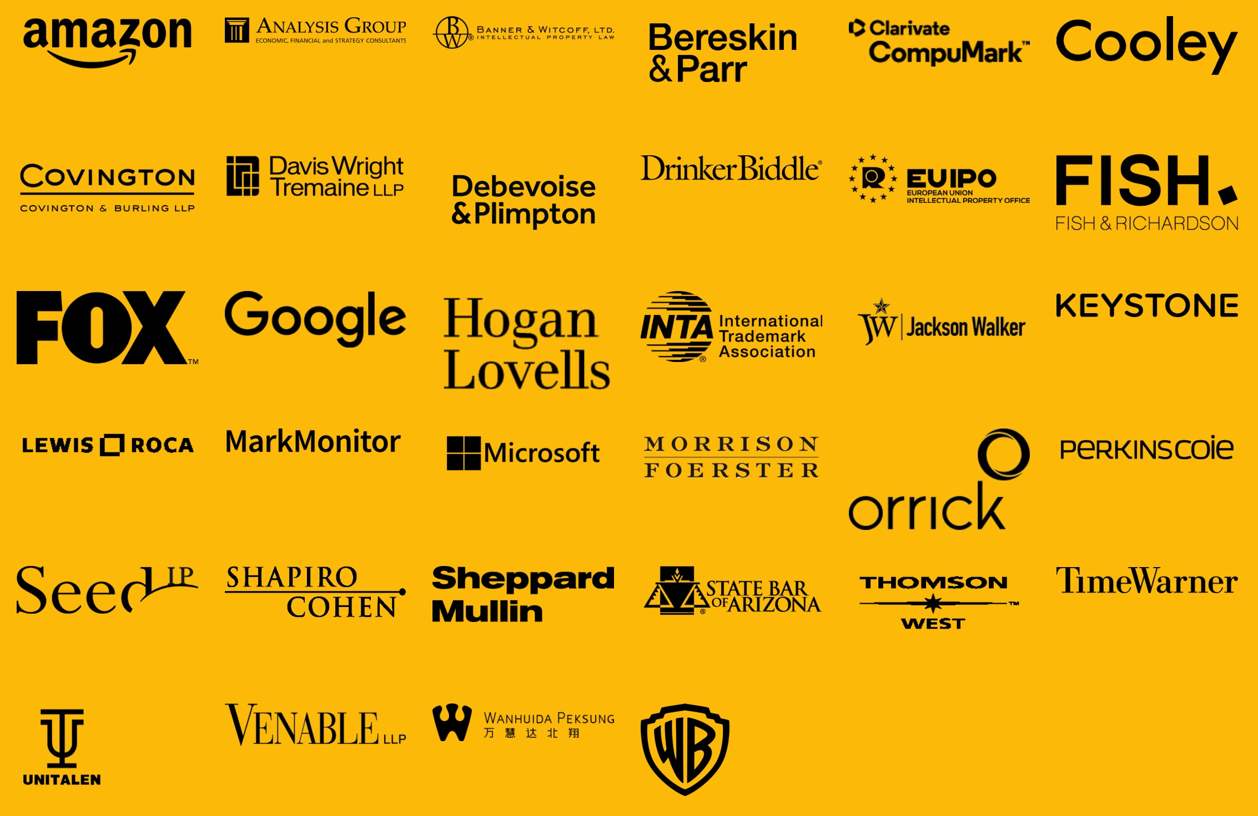


Trademark Law
Year in Review

Slide 2

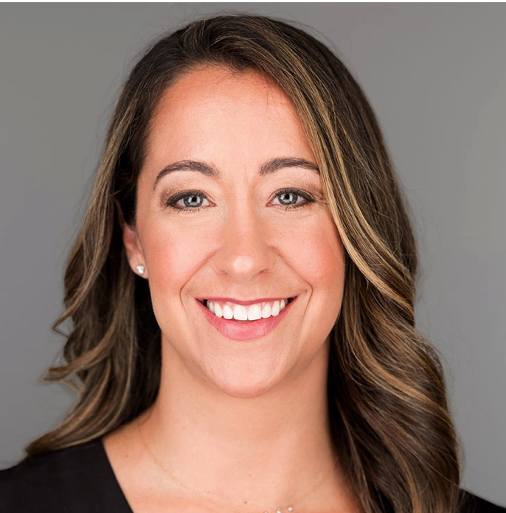
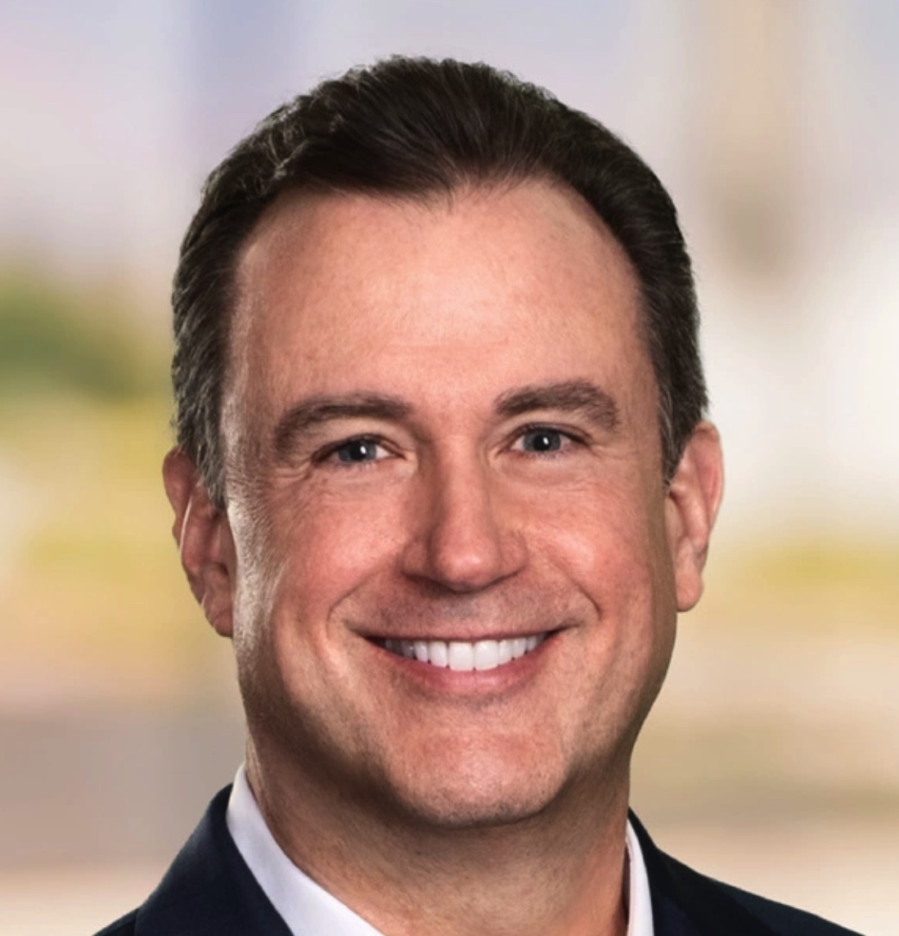
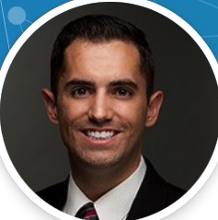
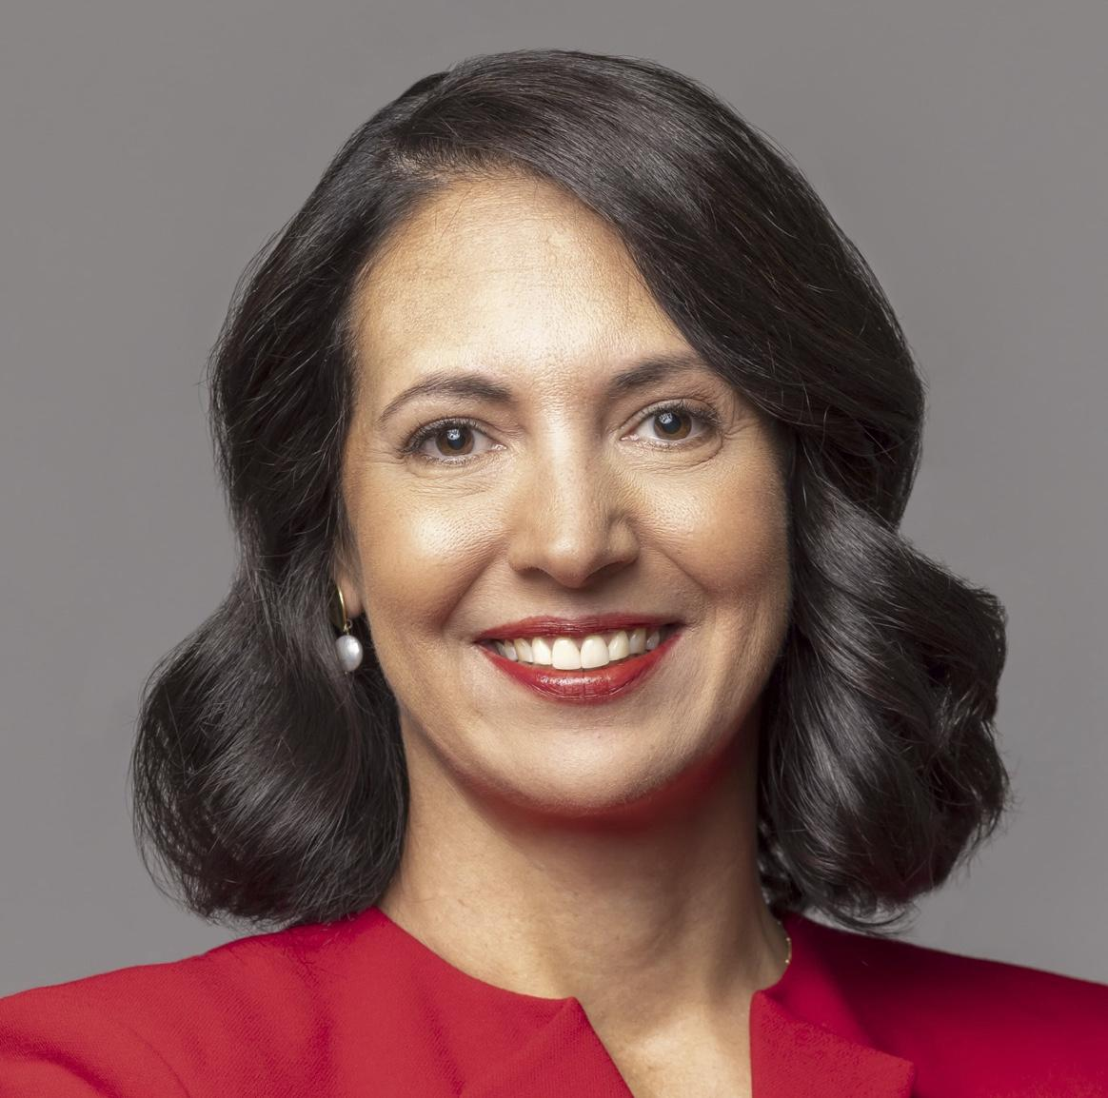
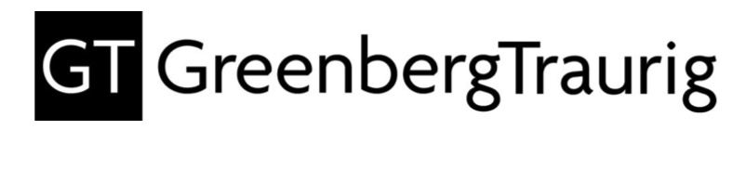
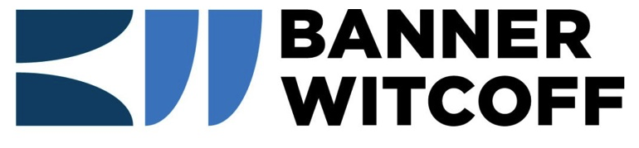
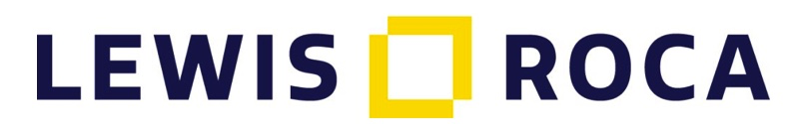

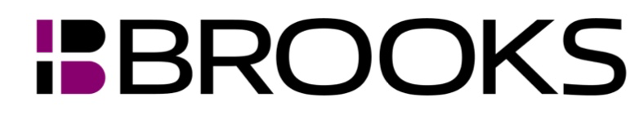
Panelists
Stephen Baird
Katie Laatch Fink
Michael McCue
Justin Powley
Hope Shovein

Slide 3
Topics
Impacts of the Trademark Modernization Act
Trademark Fraud
Digital Marketplaces & Secondary Liability
Trademarks in the Metaverse
Notes:
Proposed Questions:
Questions for Trademark Fraud section (Steve/Justin):
Hope and Katie just provided us an update on the Trademark Modernization Act, including the new procedures for cancelling fraudulent registrations. How do you view Chutter and Galperti in the context of the Trademark Modernization Act?
What are the best practices to avoid fraud challenges, is it a good practice for lawyers to sign verified statements submitted to the USPTO, any difference between in-house counsel and outside counsel?
How much due diligence is required to avoid a successful fraud challenge to a provably false statement if the Federal Circuit agrees that reckless disregard for the truth is sufficient to prove fraud?
When you are advising a client/business on a trademark filing relying on acquired distinctiveness, how do you evaluate third-party uses as ‘significant,’ or merely ‘inconsequential or infringing.’?

Slide 4
The Trademark Modernization Act
The Trademark Modernization Act of 2020 (TMA) amended the Lanham Act in several key aspects:
Created new tools to remove trademark registrations;
Shortened response deadlines to office actions;
Codified and expanded Letters of Protest; and
Restored the rebuttable presumption of irreparable harm.
Regulations implementing the TMA went into effect on December 18, 2021.
Final Rule available via https://www.uspto.gov/subscription-center/2021/uspto-implements-trademark-modernization-act-final-rule.
Notes:
Hope

Slide 5
The Trademark Modernization Act
Shortened Office Action Response Period:
Office action response periods will be shortened from six to three months. Applicants will have the option to obtain one three-month extension for a $125 fee. (Applications filed under Section 66(a) are exempt from the shortened timeframe.)
Ultimately this should unclutter the federal register of applications that will ultimately be abandoned.
Implementation of this shorter response period delayed until December 1, 2022, to allow the PTO and others update systems.
Notes:
Hope

Slide 6
The Trademark Modernization Act
The TMA codified the long-standing practice for submitting Letters of Protest:
The PTO issued rules setting out the letter of protest procedures (https://www.uspto.gov/trademarks/trademark-updates-and-announcements/letter-protest-practice-tip) and a $50.00 fee that went into effect on January 2, 2021.
The TMA requires the PTO to act on letters of protest within two months of receipt.
Third parties may submit for consideration for inclusion in the record evidence relevant to a ground for refusal of registration.
Note: Consider changing watch notices to when a third-party application is filed rather than when it is published.
Notes:
Hope

Slide 7
The Trademark Modernization Act
Restoration of Presumption of Irreparable Harm:
The TMA restored the rebuttable presumption of irreparable harm in jurisdictions that have dismissed it, increasing brand owners’ chances of successfully obtaining injunctive relief.
Section 34(a) now provides that a plaintiff is entitled to a rebuttable presumption of irreparable harm upon a finding of a likelihood of success on the merits for a preliminary injunction, or a finding of infringement for a permanent injunction.
In short, eBay Inc. v. MercExchange, 547 U.S. 388 (2006) does not apply to trademark cases.
Notes:
Hope

Slide 8
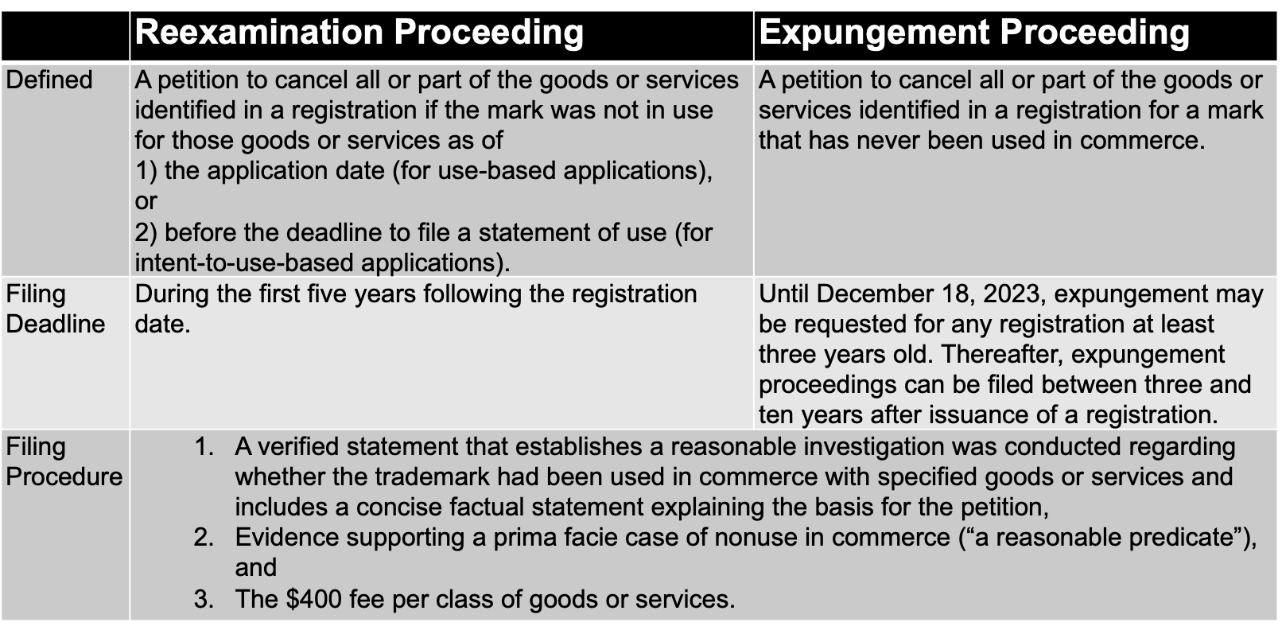
New Ex Parte Proceedings

Slide 9
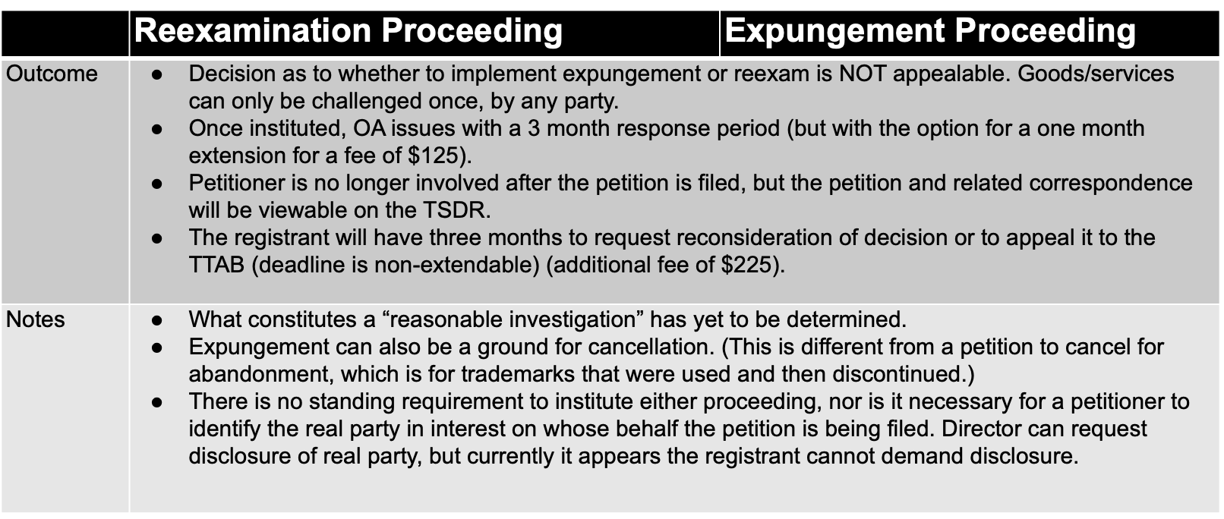
New Ex Parte Proceedings

Slide 10
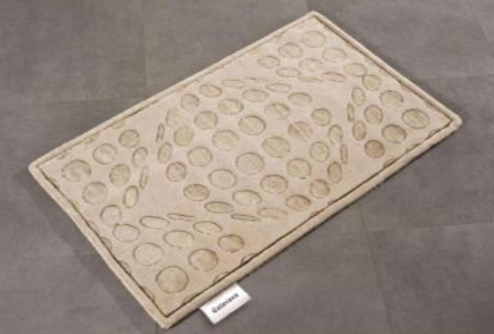
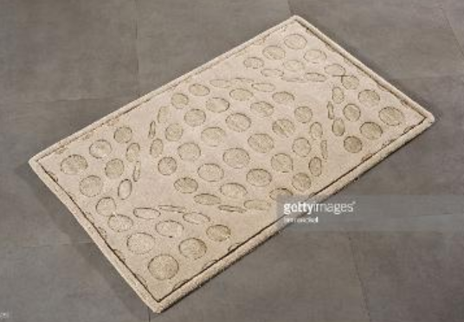
The First Expungement Case
GALAVAVA (RN 5513424):
Filed December 21, 2021
Expungement – claim the mark was never in use
Cl. 27: various floor coverings
Basis: Filing attorney noticed that the specimen appeared identical to a Getty stock image
Galavava.com out of service & no use on Amazon or Walmart

Slide 11
GALAVAVA Expungement
Jan. 25, 2022: Inquiry letter sent to Petitioner regarding illegible URL and date information in webpage evidence; petitioner responded the same day with revised exhibits.
Feb. 11, 2022: Notice of Institution as to some of the goods; registrant given 3 months to respond.
  Evidence must establish use of the mark in commerce before the filing date of the granted petition to expunge, December 21, 2021.
  Specimens of use (but not previously submitted specimens alone).
  Delete goods.

Slide 12
The First Ex Parte Reexamination
WATERBIRD (RNs 5939922, 5940037, 6140514):
Filed: December 31, 2021.
Reexamination: claim marks not in use when filed based on 1(a).
Basis: Statements on social media and podcasts re timing and location of use.
Class 33: Distilled spirits; Prepared alcoholic cocktail
Feb. 14, 2022: Notice of Institution; registrant given 3 months to respond
  Evidence must establish use of the mark in commerce as of the filing date
  Specimens of use (but not previously submitted specimens alone)
  Delete goods

Slide 13
Unsuccessful Reexamination
THE COOP (RN 5186403): Not Instituted
Filed January 3, 2022
Reexamination – claim marks not in use
Cl. 43: Restaurant Services
Feb. 17, 2022: Proceeding not instituted
  No prima facie case that not in use as of filing date
  Evidence does not comply with rules
“I am the owner of a food truck called The Coop in Connecticut. A restaurant a couple of towns over has just changed its name to The Coop with the same brand colors as well as a similar logo and menu to my business. I am attempting to own the primary class trademark for The Coop in order to protect my business and brand. Since 2017 the trademark #87173514 is not in use in commerce for the specified goods or services. Google as well as Yelp lists this business as closed. Their website is no longer active, and their phone number is no longer in service. The Coop is no longer at their listed address. After searching for a new location, no such place was found. The latest review that was found was from 2017. No relative information proving this business is still active has been found. I have attempted to reach out to the lawyer who submitted the trademark application and received no response. I have also tried finding any other contact information for the business owner and had no success.”

Slide 14
Topics
Impacts of the Trademark Modernization Act
Trademark Fraud
Digital Marketplaces & Secondary Liability
Trademarks in the Metaverse
Notes:
Proposed Questions:
Questions for Trademark Fraud section (Steve/Justin):
Hope and Katie just provided us an update on the Trademark Modernization Act, including the new procedures for cancelling fraudulent registrations. How do you view Chutter and Galperti in the context of the Trademark Modernization Act?
What are the best practices to avoid fraud challenges, is it a good practice for lawyers to sign verified statements submitted to the USPTO, any difference between in-house counsel and outside counsel?
How much due diligence is required to avoid a successful fraud challenge to a provably false statement if the Federal Circuit agrees that reckless disregard for the truth is sufficient to prove fraud?
When you are advising a client/business on a trademark filing relying on acquired distinctiveness, how do you evaluate third-party uses as ‘significant,’ or merely ‘inconsequential or infringing.’?

Slide 15
Trademark Fraud
Topics for Discussion
Chutter, Inc. v. Great Mgmt. Grp., LLC
“Reckless Disregard” for Truth at the TTAB
Galperti, Inc. v. Galperti S.r.L.
2(f) Secondary Meaning and Validity at the CAFC

Slide 16
Trademark Fraud: Big Picture
Trademark fraud has emerged again as a very hot topic, thanks to Chutter and Galperti in 2021, trademark fraud has been very quiet since Bose in 2009
Over the last nearly two decades, the legal standard of trademark fraud at the USPTO has evolved
It appears to be swinging like a pendulum, creating significant challenges for trademark owners and counsel
Every paper filed with the Trademark Office technically carries the risk of a fraud challenge
Even when you know you can defeat a fraud challenge, you still may lose, so caution is wise:
  Unnecessarily surrenders leverage and emboldens adversary
  Complicates issues in case and increases cost of successful defense
  May lead to attorney as fact witness, client relationship issues, and possible finger pointing

Slide 17
Trademark Fraud: Big Picture
Fraud is a statutory defense to “incontestability” (15 U.S.C. §1115(b)(1))
Fraudulently obtained/maintained registrations may be cancelled “at any time” (15 U.S.C. §1064(3))
Not protected by the typical five-year statute of limitations that prevents most other statutory grounds for cancellation
Legal consequences of a successful fraud challenge can be a significant payoff, especially if it alters priority in a case
Fraud cannot be cured and results in complete cancellation, as opposed to cancellation of only the portion of the registration impacted by the fraud

Slide 18
Trademark Fraud: Big Picture
Once upon a time, until 2003, trademark fraud claims were considered highly disfavored
They were criticized as unproductive litigation diversions – “often pled,” but “rarely proven”
To succeed — during the period prior to 2003, the alleged fraud had to be “proven to the hilt,” with “clear and convincing evidence,” leaving nothing to “speculation, conjecture or surmise”
All doubts had to be resolved against the party making the claim and in favor of the accused
In those days, falsity was not necessarily fraud — fraud was really fraud
Given the seriousness of the charge, the focus was directed to whether the accused had the requisite subjective intent to deceive the USPTO, while knowingly making false statements of material fact.
Mere inadvertence, sloppiness, carelessness, ignorance, honest mistakes or misunderstandings, and negligent — even grossly negligent — falsity or omissions were excused because they could not satisfy the very significant clear and convincing standard

Slide 19
Trademark Fraud: Medinol
Then, the fraud pendulum swung in the opposite direction — let’s call it the Medinol era — extending from 2003-2009
During that period, the TTAB of the USPTO, granted fraud-based trademark oppositions and cancellations at a record pace, even on summary judgment (sometimes even sua sponte, as was the case in Medinol)
The TTAB did so by employing a much easier-to-prove strict liability or mere negligence standard, requiring only that the accused either knew or “should have known” the material statement was false:
  In Medinol, Neuro Vasx had an ITU application mature into a registration covering “medical devices, namely, neurological stents and catheters”
  However, it admitted in the answer to a cancellation action that it, in fact, had never used the mark in connection with “stents,” only “catheters,” either at the time of filing its statement of use or later
  Concerned about the solemnity of the sworn statements made when filing trademark documents with the PTO, sua sponte, the TTAB entered summary judgment against Neuro Vasx
  Medinol holding: “A trademark applicant commits fraud in procuring a registration when it makes material representations of fact in its declaration which it knows or should know to be false or misleading”
  That the improper inclusion of stents was “’apparently overlooked’ – does nothing to undercut the conclusion that respondent knew or should have known that its statement of use was materially incorrect”
  “Respondent’s knowledge that its mark was not in use on stents – or its reckless disregard for the truth – is all that is required to establish intent to commit fraud in the procurement of a registration.”
After Medinol, if a trademark owner knew or “should have known” it made a materially false statement to the Trademark Office, the entire resulting trademark registration was subject to cancellation at any time
Most of the successful fraud cases during the Medinol-era fell into the “overinclusive goods and services” category of fraud cases

Slide 20
Trademark Fraud: Bose
Then came Bose in 2009, and the pendulum swung back again: “Subjective intent to deceive, however difficult it may be to prove, is an indispensable element in the [fraud] analysis.”
In Bose, the CAFC indicated the TTAB had read “too broadly” prior CAFC precedent that had mentioned the words “should have known.”
It specifically reaffirmed “that a trademark is obtained fraudulently under the Lanham Act only if the applicant or registrant knowingly makes a false, material representation with the intent to deceive the PTO.”
The CAFC appeared to agree with the Board that “objective manifestations” are relevant to the fraud analysis because “intent must often be inferred from the circumstances and related statement made.”
But it firmly disagreed with “equating ‘should have known’ of the falsity with a subjective intent,” because in doing so, “the Board erroneously lowered the fraud standard to a simple negligence standard.”

Slide 21
Trademark Fraud Bose
It further redirected the TTAB: “Unless the challenger can point to evidence to support an inference of deceptive intent, it has failed to satisfy the clear and convincing evidence standard required to establish a fraud claim.”
  The Bose case implicated a renewal application (under Sections 8 and 9 of the Lanham Act), signed by the General Counsel of Bose Corporation, claiming current use of the WAVE trademark in connection with a variety of goods, including “audio tape recorders and players.”
  These virtually archaic products were not excluded from the renewal application even though Bose had stopped manufacturing and selling them 4-5 years earlier, and even though the General Counsel “knew that Bose discontinued those products when he signed the Section 8/9 renewal.”
  He gave testimony, however, that he believed it was proper to not exclude the items from the listing of goods since Bose continued to repair such items and ship the repaired items back to customers across state lines, in interstate commerce
  The Board considered the General Counsel’s belief “unreasonable” (since Bose was providing repair services, not offering goods with this activity), specifically finding fraudulent procurement and maintenance of a trademark registration with an over-inclusive listing of goods
  It’s important to keep in mind that the Federal Circuit in Bose made perfectly clear: “We do not need to resolve the issue of reasonableness as it is not part of the analysis”.
  “Unless the challenger can point to evidence to support an inference of deceptive intent, it has failed to satisfy the clear and convincing evidence standard required to establish a fraud claim.”
  The involved conduct, viewed considering all the evidence, must be of sufficient culpability to require a finding of intent to deceive
  “We hold that a trademark is obtained fraudulently under the Lanham Act only if the applicant or registrant knowingly makes a false, material representation with the intent to deceive the PTO.”
  Stated another way, the CAFC ruled: “There is no fraud if the false representation is occasioned by an honest misunderstanding or inadvertence without a willful intent to deceive.”

Slide 22
Trademark Fraud: Bose
The Federal Circuit refrained from deciding whether reckless disregard for the truth will suffice, since it disagreed with the TTAB that the facts of the Bose case even satisfied the lower recklessness standard of proof
Despite the PTO’s specific request in the Bose appeal for the CAFC to endorse a “reckless disregard” standard for fraud determinations, this panel of the CAFC, saved for another day that determination
Footnote 2 in Bose: “[E]ven if we were to assume that reckless disregard qualifies, there is no basis for finding [Bose’s] conduct reckless.”
  In-house counsel at Bose signs under oath trademark renewal documents indicating that, at least as of 2001, the WAVE trademark was still in use in commerce on various goods, including audio tape recorders and players;
  Bose stopped manufacturing and selling audio tape recorders and players sometime between 1996 and 1997
  The GC knew that Bose discontinued those products when he signed the renewal documents, but he believed (unreasonably, according to the TTAB) that the WAVE mark still was used in commerce because "in the process of repairs, the product was being transported back to customers";
  Before Bose submitted the 2001 declaration of use, neither the USPTO nor any court had interpreted "use in commerce" to exclude the repairing and shipping of repaired goods
For the next five years following the 2009 Bose decision, those who closely follow trademark fraud case law might have concluded that no set of facts could meet the stringent Bose standard
But then came the Nationstar Mortgage case, the first post-Bose TTAB decision finding trademark fraud, a precedential decision in 2014
Perhaps the TTAB’s focus on “evidence that applicant did not have a good faith reasonable basis for believing that he was using [his] mark in commerce for all the services identified in the application” foreshadowed a belief that another swing of the pendulum was appropriate

Slide 23
Trademark Fraud: Chutter
In the TTAB’s 24th precedential decision of 2021, the Board finally answered the question the CAFC left unresolved in Bose, namely, whether reckless disregard for the truth can satisfy the trademark fraud standard
As predicted, more than a decade ago, the TTAB didn’t wait for the CAFC to decide the question itself, instead the TTAB has decided that reckless disregard is sufficient to prove trademark fraud before the USPTO:
  Petitioner Chutter’s fraud claim relied on Registrant’s false Section 15 Declaration that there were no civil actions or USPTO proceedings pending against the DANTANNA’S mark and registration for steak and seafood restaurant services
  Because there was a pending cancellation action and pending civil action involving the DANTANNA’S mark, Petitioner Chutter alleged the false statement was made with the intent to deceive the USPTO into “accepting” the Declaration
  “A false Section 15 affidavit/declaration, when relied on by the USPTO, allows a registrant to obtain a new right which it would not otherwise have, specifically, the right to have its registration, in litigation, accepted as conclusive evidence . . . .”
  It was undisputed that outside counsel who signed the Section 15 Declaration knew there were proceedings pending, and that he wasn’t aware of the requirements for filing a Section 15 Declaration
  Outside counsel admitted to not reviewing the Section 15 Declaration “carefully enough” to note the falsity of the statement, and neither outside counsel nor Registrant ever notified the USPTO of the false statement of which it was aware back in 2015

Slide 24
Trademark Fraud: Chutter
Chutter argued that this conduct amounted to “willful blindness” or “reckless disregard” to the truth of the Declaration and the TTAB agreed it amounted to “reckless disregard” for the truth:
  “Reckless disregard” is defined as the “conscious indifference to the consequences of an act.” BLACK’S LAW DICTIONARY
  “A declarant is charged with knowing what is in the declaration being signed, and by failing to make an appropriate inquiry into the accuracy of the statements the declarant acts with a reckless disregard for the truth.”
  Outside counsel “paid little, or no, attention to the document he was signing under oath and thereby disregarded the significance of the benefits he was obtaining for his client. By failing to ascertain and understand the import of the document he was signing, far from conscientiously fulfilling his duties as counsel, Mr. Taylor acted in reckless disregard for the truth; nor did he take any action to remedy the error once it was brought to his attention.”
  According to the TTAB, not finding fraud under these facts could “encourage declarants to conclude that such disregard carries no consequences and they can fail to read documents they are signing without penalty. ‘Statements made with such degree of solemnity clearly are or should be investigated thoroughly prior to submission and signature to the USPTO.’”
  As to the willful intent to deceive requirement of Bose, the TTAB noted that Supreme Court and other circuit courts of appeal have ruled that willful includes “reckless behavior”
  Accordingly, the TTAB held: “In matters of trademark registration and maintenance, where the USPTO relies on declarations to be complete, accurate, and truthful . . . reckless disregard is equivalent to intent to deceive and satisfies the intent to deceive requirement.”
In November 2021, the Board’s Chutter decision was appealed to the CAFC, so we should learn the result of that appeal during 2022.

Slide 25


Trademark Fraud: Galperti
Background
GALPERTI S.r.l., an Italian LLC
(Galperti Italy)
GALPERTI, Inc., a Texas Corporation
(Galperti USA)
Both manufacture and sell metal flanges and related products

Slide 26
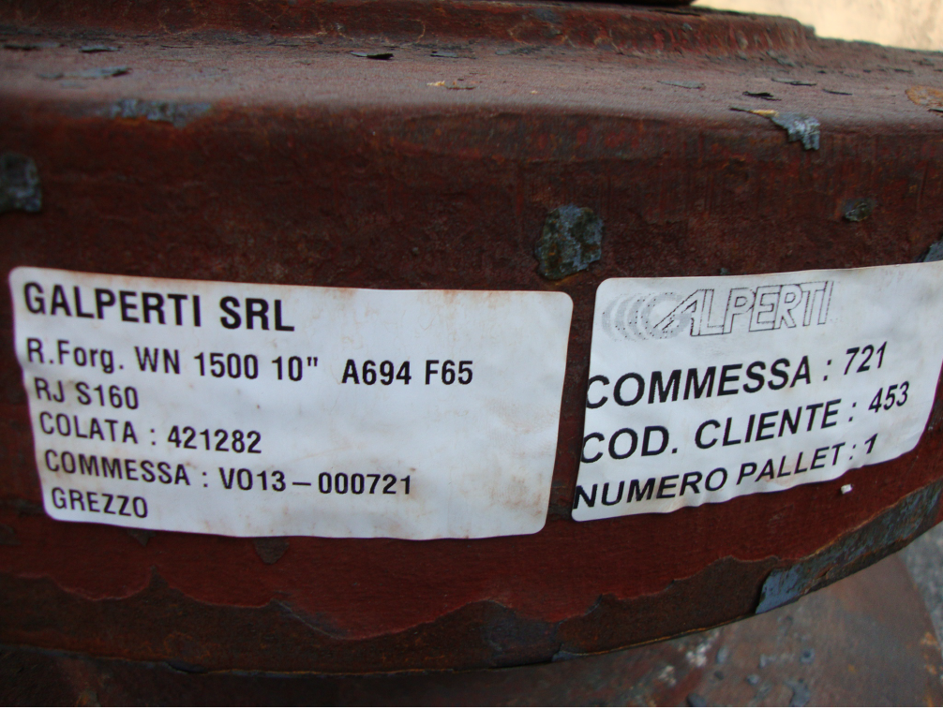
Trademark Fraud: Galperti
Background
In 2007 Galperti Italy filed a trademark application for GALPERTI
  Class 006 - Ironmongery in the form of metal hardware, namely, flanges, ring-shaped fittings of metal, and forgings
GALPERTI is a surname
  Initial rejection under Lanham Act § 2(e)(4)
Galperti Italy claims acquired distinctiveness
under § 2(f), asserting “substantially
exclusive use”
Registration granted in 2008

Slide 27
Trademark Fraud: Galperti
Cancellation Rd. 1
Galperti USA petitions to cancel GALPERTI registration
  Galperti USA’s use predated Galperti Italy‘s use and was likely to cause consumer confusion
  Galperti Italy obtained the registration by fraud by intentionally making a false declaration of “substantially exclusive use”
  Galperti Italy obtained the registration by fraud by making a false claim of ownership

Slide 28
Trademark Fraud: Galperti
Cancellation Rd. 1, cont.
After a trial, TTAB dismissed the petition to cancel:
  Galperti USA unable to show priority
  Claim of “substantially exclusive use” was not per se false
  Disputed priority date was immaterial
CAFC vacates the TTAB’s determination on ground (#2) - intentionally making a false declaration of “substantially exclusive use”
  2(f) “substantially exclusive and continuous use”
  Remands – third party use “significant or inconsequential”

Slide 29
Trademark Fraud: Galperti
Cancellation Rd. 2
TTAB again rejects claim of fraud:
  Galperti USA must demonstrate secondary meaning of its own use of GALPERTI
  Third-party use is irrelevant unless in privity
CFAC again vacates and remands:
  Secondary meaning not required for challenger
  Any use can undermine claim of exclusivity: privity not required

Slide 30
Trademark Fraud: Galperti
Key Takeaways
Back to the TTAB again.
Evidence of use of a mark even without a showing of secondary meaning, by any party, is relevant to demonstrate that an assertion of “substantially exclusive use” was false.
CAFC: “We do not reach the intent aspect of the charge of fraud, which the Board has not addressed.”

Slide 31
Topics
Impacts of the Trademark Modernization Act
Trademark Fraud
Digital Marketplaces & Secondary Liability
Trademarks in the Metaverse
Notes:
Proposed Questions:
Questions for Trademark Fraud section (Steve/Justin):
Hope and Katie just provided us an update on the Trademark Modernization Act, including the new procedures for cancelling fraudulent registrations. How do you view Chutter and Galperti in the context of the Trademark Modernization Act?
What are the best practices to avoid fraud challenges, is it a good practice for lawyers to sign verified statements submitted to the USPTO, any difference between in-house counsel and outside counsel?
How much due diligence is required to avoid a successful fraud challenge to a provably false statement if the Federal Circuit agrees that reckless disregard for the truth is sufficient to prove fraud?
When you are advising a client/business on a trademark filing relying on acquired distinctiveness, how do you evaluate third-party uses as ‘significant,’ or merely ‘inconsequential or infringing.’?

Slide 32
Digital Marketplaces &
Secondary Liability
Introduction to Secondary Liability for Trademark Infringement
The State of the Law
Government Action

Slide 33
Vicarious v. Contributory Infringement
Under what circumstances is a digital marketplace liable for trademark infringement committed by a third-party seller?
Vicarious Infringement | Contributory Infringement
1. Principal/agent relationship between platform and infringer | Actual or constructive knowledge of the infringement or willful blindness
2. Direct financial interest of the platform in the infringement | 2. Direct control or monitoring of the instrumentality for the infringement

Slide 34


Seminal Case: v.
For contributory infringement to apply, eBay “must have more than a general knowledge or reason to know that its service is being used to sell counterfeit goods.”
eBay had no duty to investigate the authenticity of the Tiffany products sold through its platform or to take further steps to prevent the sale of counterfeit products.
The burden of identifying and seeking the removal of counterfeit products from eBay’s site fell on Tiffany.

Slide 35
Recent Cases
Chanel v. The Real Real, 449 F.Supp.3d 422 (S.D.N.Y. 2020)
Annie Oakley Enterprises, Inc. v. Amazon.com, Inc., 2021 WL 4147189 (S.D. Ind. 2021)
Omega SA v. 375 Canal, LLC, 984 F.3d 244 (2d Cir. 2021)

Slide 36
After Tiffany v. eBay
Marketplaces are not contributorily liable for trademark infringement committed by a third-party seller unless:
  The third-party seller engaged in direct trademark infringement; and
  The marketplace ignored cease and desist letters or takedown notices that specifically identified the listings at issue.
Marketplaces are directly liable for trademark infringement if they sold the infringing products at issue.

Slide 37
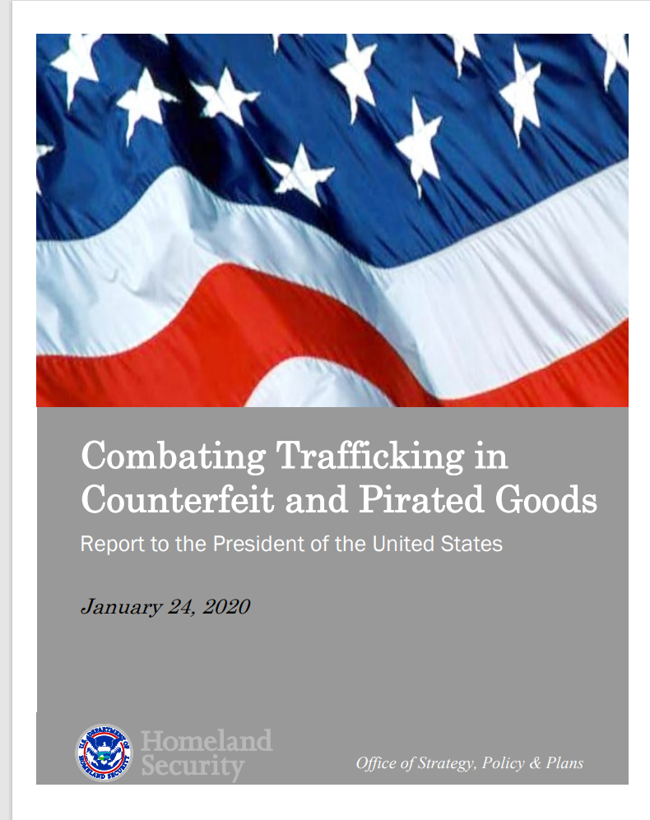
DHS Involvement (Jan. 2020)
“It is critical that immediate action be taken to protect American consumers and other stakeholders against the harm and losses inflicted by counterfeiters.”

Slide 38
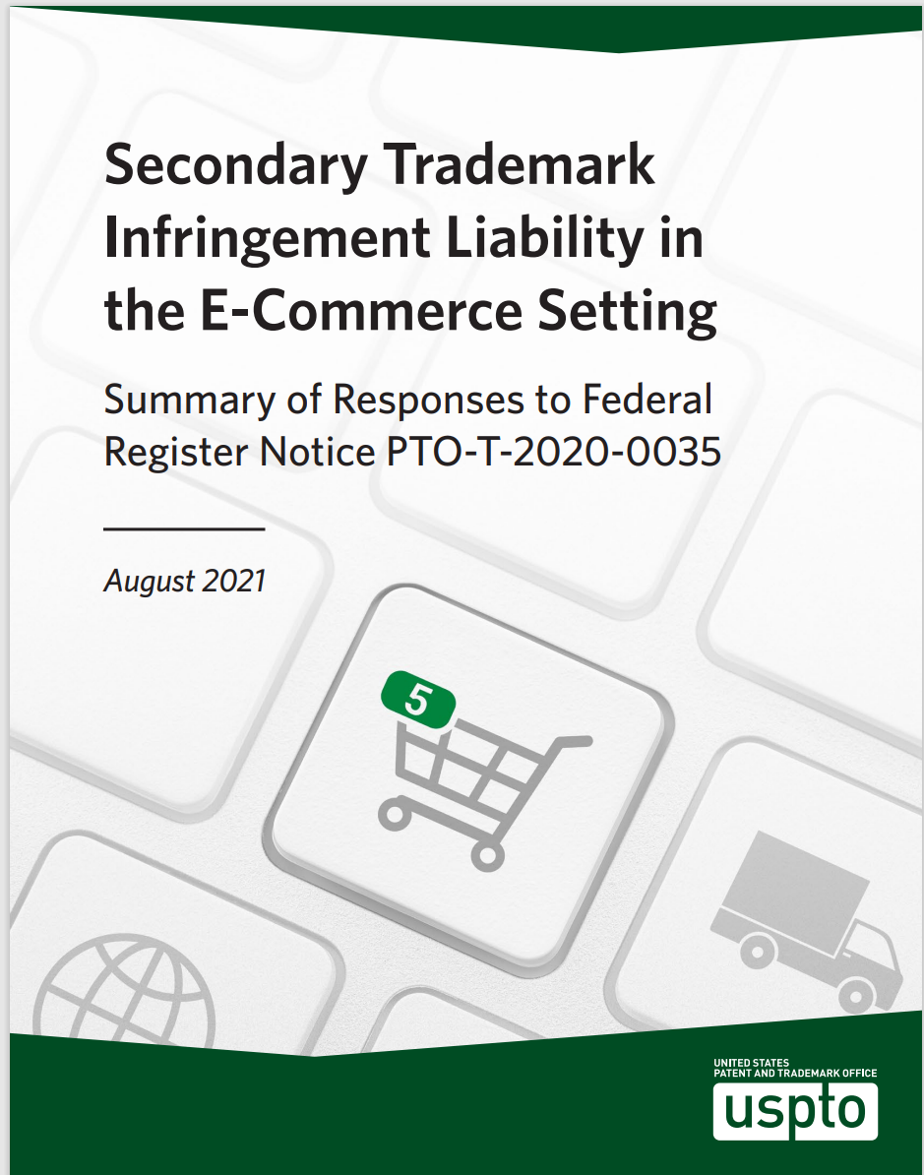
USPTO Involvement (Aug. 2021)
The respondents proposing change “unanimously agree that the doctrine of secondary trademark infringement liability, as currently applied by the courts, is not an effective tool in addressing the problem of counterfeit goods sold through the internet.”

Slide 39
Brand Owners’ Arguments
The knowledge standard is too difficult to meet.
Burden of enforcement falls disproportionately on brand owners.
Patchwork of rules, procedures and evidence requirements that brand owners must navigate.
Platforms are incentivized not to vet sellers/products to avoid the requisite knowledge.
The enforcement process is reactive, not proactive.

Slide 40
Marketplaces’ Arguments
Harmful to competition in the secondary market for genuine goods.
Will increase trademark bullying.
Trademark owners will stop pursuing the bad actors.
Digital marketplaces are not equipped to identify counterfeit goods.
Changes to the law could harm innocent intermediaries.

Slide 41
SHOP SAFE Act (HR 5374/S 1843)
Stopping
Harmful
Offenders on
Platforms by
Screening
Against
Fakes in
E-commerce

Slide 42
SHOP SAFE Act (HR 5374/S 1843)
Only applies to infringement of goods relating to health and safety.
Contributorily liable if a seller uses a counterfeit mark to advertise, offer for sale, or sell unless the platform:
  Requires the seller to have a registered agent/verified address for service of process in the US.
  Verifies the seller's identity/contact information.
  Requires the seller to agree not to use counterfeit marks.
  Implements technical measures to prescreen and remove listings for goods sold with a counterfeit mark.
  Implements policies to remove and ban repeat offenders.

Slide 43
INFORM Act (HR 5502/S 936)
Intregity,
Notification, and
Fairness in
Online
Retail
Marketplaces for Consumers

Slide 44
INFORM Act (HR 5502/S 936)
Platforms must require any high-volume third-party sellers with an aggregate total of $20,000+ in annual revenue to disclose certain information.
Disclose to Platform: bank account info, Government-issued documentation, tax ID number, and contact information (for verification by platform).
Disclose to Consumers: name, physical address, and contract information for the high-volume seller and any seller from whom they obtained the product purchased.
Platform must suspend any high-volume third-party seller until they comply.
FTC and State Attorneys’ General can enforce.

Slide 45
What’s Next?
Legislation to impose more requirements on platforms and marketplaces to vet third-party sellers and disclose information about them.
More lawsuits by brand owners against platforms and direct infringers.
Greater efforts by direct infringers to conceal their identities.

Slide 46
Topics
Impacts of the Trademark Modernization Act
Trademark Fraud
Digital Marketplaces & Secondary Liability
Trademarks in the Metaverse
Notes:
Proposed Questions:
Questions for Trademark Fraud section (Steve/Justin):
Hope and Katie just provided us an update on the Trademark Modernization Act, including the new procedures for cancelling fraudulent registrations. How do you view Chutter and Galperti in the context of the Trademark Modernization Act?
What are the best practices to avoid fraud challenges, is it a good practice for lawyers to sign verified statements submitted to the USPTO, any difference between in-house counsel and outside counsel?
How much due diligence is required to avoid a successful fraud challenge to a provably false statement if the Federal Circuit agrees that reckless disregard for the truth is sufficient to prove fraud?
When you are advising a client/business on a trademark filing relying on acquired distinctiveness, how do you evaluate third-party uses as ‘significant,’ or merely ‘inconsequential or infringing.’?

Slide 47
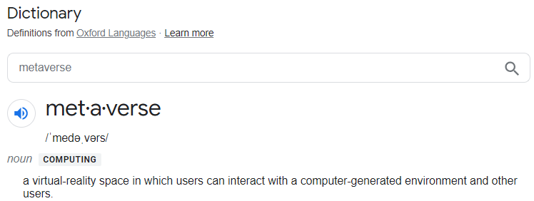
The Metaverse
There has been a significant rise in the number of trademark applications to protect goods and/or services in the virtual world and, in particular, in what is now being referred to as the “metaverse.”
Of the 346 active U.S. trademark applications with identifications of goods/services including the term “metaverse,” 303 were filed since the October 28, 2021 announcement from Facebook that it was changing its parent entity/holding company name to Meta, in part due to the company’s virtual-reality vision for the future.
Of the approx. 445 active U.S. trademark applications/registrations containing the META- prefix with identifications of goods/services including the terms “metaverse” or “virtual,” approx. 295 were filed since the Facebook announcement.
Notes:
Hope
Similar to the rush on registering domain names a few decades ago and filing new trademark applications covering the provision of services online.

Slide 48
The Metaverse
These new applications for goods and services in the virtual world/metaverse are primarily Classes 9, 35, and 41:
CONVERSE SN: 97107367 Filed: November 3, 2021 | Class 9: Downloadable virtual goods, namely, computer programs featuring footwear, clothing, headwear, eyewear, bags, sports bags, backpacks, sports equipment, art, toys and accessories for use online and in online virtual worlds Class 35: Retail store services featuring virtual goods, namely, footwear, clothing, headwear, eyewear, sports bags, backpacks, sports equipment, art, toys and accessories for use online; on-line retail store services featuring virtual merchandise, namely, footwear, clothing, headwear, eyewear, bags, sports bags, backpacks, sports equipment, art, toys and accessories Class 41: Entertainment services, namely, providing on-line, non-downloadable virtual footwear, clothing, headwear, eyewear, bags, sports bags, backpacks, sports equipment, art, toys and accessories for use in virtual environments
ANTHROPOLOGIE SN: 97118161 Filed: November 10, 2021 | Class 9: Downloadable virtual goods, namely, computer programs featuring clothing, footwear, headwear, eyewear, home decor, general house wares, furniture, cosmetics, cosmetics and personal care items, clothing and hair accessories, jewelry, handbags, sports bags, backpacks, electronics, rugs and gifts consisting of the aforementioned goods for use online and in online virtual worlds Class 35: Retail store services featuring virtual goods, namely, clothing, footwear, headwear, eyewear, home decor, general house wares, furniture, cosmetics, cosmetics and personal care items, clothing and hair accessories, jewelry, handbags, sports bags, backpacks, electronics, rugs and gifts consisting of the aforementioned goods for use online; on-line retail store services featuring virtual merchandise, namely, clothing, footwear, headwear, eyewear, home decor, general house wares, furniture, cosmetics, cosmetics and personal care items, clothing and hair accessories, jewelry, handbags, sports bags, backpacks, electronics, rugs and gifts consisting of the aforementioned goods Class 41:Entertainment services, namely, providing on-line, non-downloadable virtual clothing, footwear, headwear, eyewear, home decor, general house wares, furniture, cosmetics, cosmetics and personal care items, clothing and hair accessories, jewelry, handbags, sports bags, backpacks, electronics, rugs and gifts consisting of the aforementioned goods for use in virtual environments

Slide 49
POTTERY BARN SN: 97231081 Filed: January 21, 2022 | Class 9: Downloadable virtual goods, namely, furniture, mirrors, lighting, lamps, bedding, rugs, home décor and general housewares consisting of the aforementioned goods for use online and in online virtual worlds; downloadable software in the nature of a mobile application for users to browse and perform electronic transactions involving virtual retail consumer goods featuring furniture, mirrors, lighting, lamps, bedding, rugs, home décor and general housewares; downloadable multimedia files containing artwork, text, audio, and video relating retail consumer goods featuring furniture, mirrors, lighting, lamps, bedding, rugs, home décor and general housewares authenticated by non-fungible tokens (NFTs); downloadable digital images authenticated by non-fungible tokens (NFTs); downloadable virtual goods, namely, crypto-collectibles and non-fungible tokens (NFTs); downloadable computer software in the nature of crypto-collectibles and non-fungible tokens (NFTs) Class 35: Retail and online retail store services featuring virtual goods, namely, furniture, mirrors, lighting, lamps, bedding, rugs, home décor and general housewares; on-line retail store services featuring virtual merchandise, namely, furniture, mirrors, lighting, lamps, bedding, rugs, home décor and general housewares; provision of an online marketplace for buyers and sellers of downloadable multimedia files containing artwork, text, audio and video relating to retail consumer goods featuring furniture, home décor and general housewares authenticated by non-fungible tokens (NFTs); provision of an online marketplace for buyers and sellers of downloadable digital art images authenticated by non-fungible tokens (NFTs) Class 41: Entertainment services, namely, providing on-line, non-downloadable virtual retail consumer goods featuring furniture, mirrors, lighting, lamps, bedding, rugs, home décor and general housewares for use online and in online virtual worlds; providing an online non-downloadable platform for users to browse, create, modify and manipulate virtual retail consumer goods featuring furniture, mirrors, lighting, lamps, bedding, rugs, home décor and general housewares for entertainment purposes Class 42: Crypto-collectibles and application tokens used and transferred on software as a service (SAAS); crypto-collectibles and application tokens accessed on platform as a service (PAAS); providing non-downloadable computer software in the nature of crypto-collectibles and non-fungible tokens (NFTs)

Slide 50
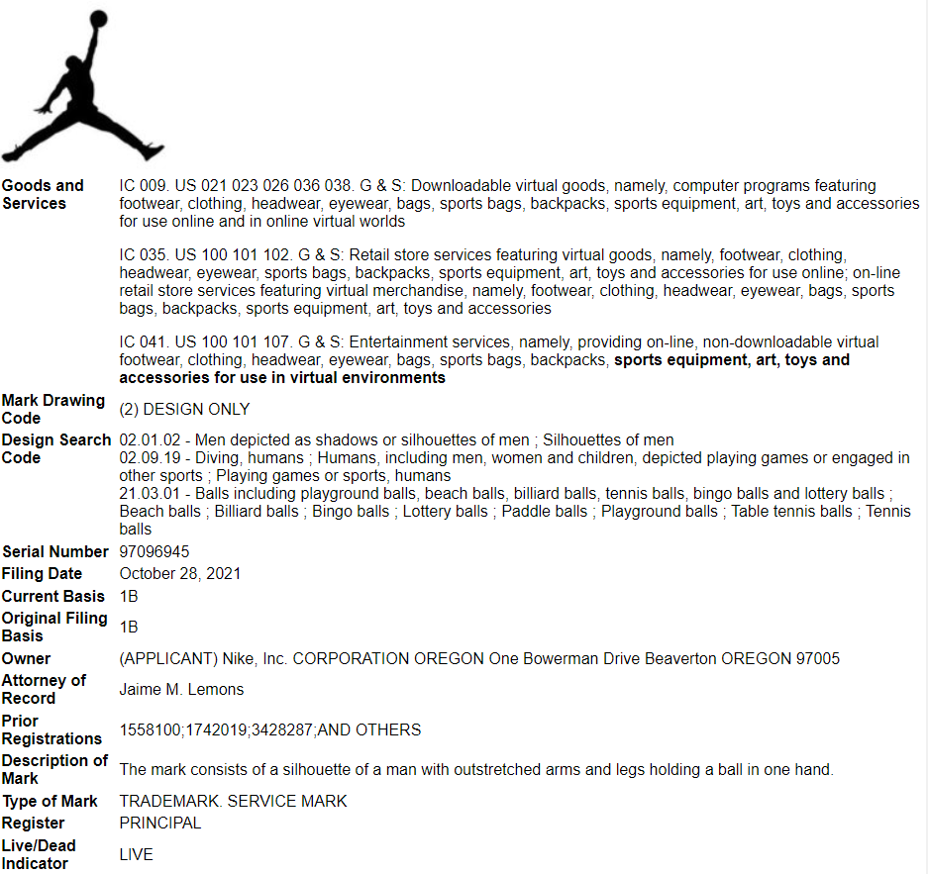

Slide 51
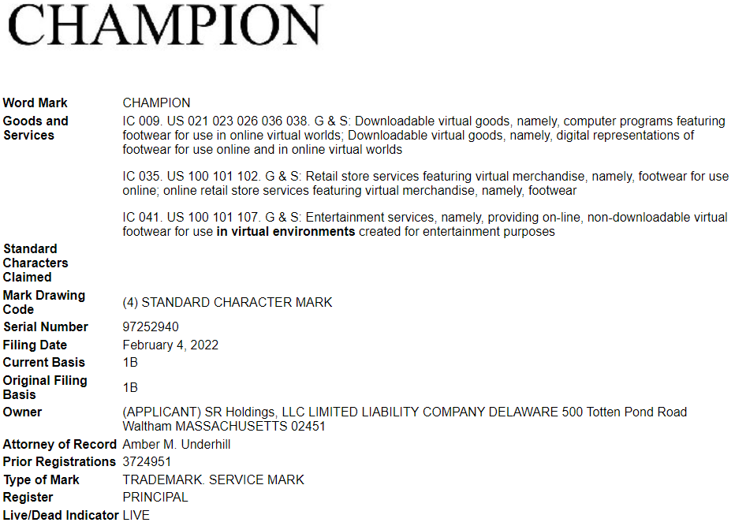

Slide 52
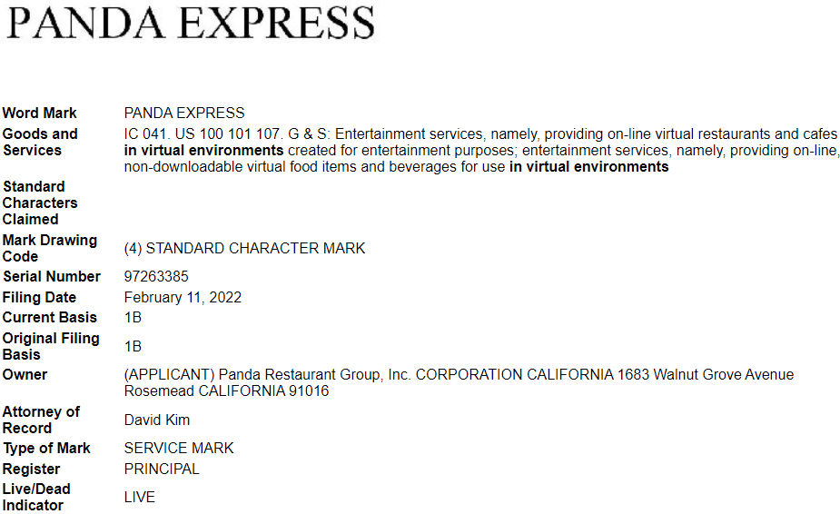

Slide 53
The Metaverse
Why consider new filings covering these realms?
    New opportunities to promote products and services;
    New business opportunities, licensing, franchising;
    Enforcement;
    The Great Unknown.

Slide 54
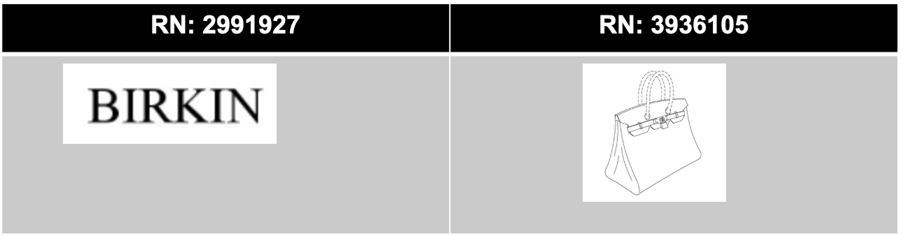
MetaBirkins Case
Hermès International et al. v. Mason Rothschild, Case No. 1:22-cv-00384 (S.D.N.Y. 2022)
Hermès filed suit against a digital artist for selling unauthorized Birkin Bag NFTs called “MetaBirkins” in the Metaverse.
Claims for trademark infringement, dilution, cybersquatting and false designations of origin.
Hermès’ asserted trademark and trade dress rights:

Slide 55

MetaBirkins Case
Mason Rothschild’s “MetaBirkins”
Collection of 100 virtual Birkin NFTs.
Launched November 2021.
Sold through online marketplace OpeanSea.

Slide 56
Topics
Impacts of the Trademark Modernization Act
Trademark Fraud
Digital Marketplaces & Secondary Liability
Trademarks in the Metaverse
Notes:
Proposed Questions:
Questions for Trademark Fraud section (Steve/Justin):
Hope and Katie just provided us an update on the Trademark Modernization Act, including the new procedures for cancelling fraudulent registrations. How do you view Chutter and Galperti in the context of the Trademark Modernization Act?
What are the best practices to avoid fraud challenges, is it a good practice for lawyers to sign verified statements submitted to the USPTO, any difference between in-house counsel and outside counsel?
How much due diligence is required to avoid a successful fraud challenge to a provably false statement if the Federal Circuit agrees that reckless disregard for the truth is sufficient to prove fraud?
When you are advising a client/business on a trademark filing relying on acquired distinctiveness, how do you evaluate third-party uses as ‘significant,’ or merely ‘inconsequential or infringing.’?

Slide 57
Thank you
Panelists
Steven Baird bairds@gtlaw.com
Katie Laatsch Fink kfink@bannerwitcoff.com
Michael McCue mmccue@lewisroca.com
Justin Powley jpowley@axon.com
Hope Shovein hshovein@brookskushman.com
Moderator
Prof. Jon Kappes jon.kappes@asu.edu
McCarthy Institute Fellow
Jake Nelson janels37@asu.edu
Notes:
Proposed Questions:
Questions for Trademark Fraud section (Steve/Justin):
Hope and Katie just provided us an update on the Trademark Modernization Act, including the new procedures for cancelling fraudulent registrations. How do you view Chutter and Galperti in the context of the Trademark Modernization Act?
What are the best practices to avoid fraud challenges, is it a good practice for lawyers to sign verified statements submitted to the USPTO, any difference between in-house counsel and outside counsel?
How much due diligence is required to avoid a successful fraud challenge to a provably false statement if the Federal Circuit agrees that reckless disregard for the truth is sufficient to prove fraud?
When you are advising a client/business on a trademark filing relying on acquired distinctiveness, how do you evaluate third-party uses as ‘significant,’ or merely ‘inconsequential or infringing.’?

