Slide 1



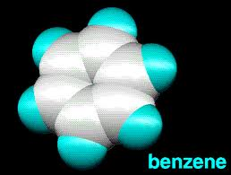
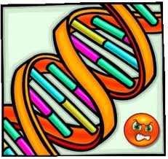

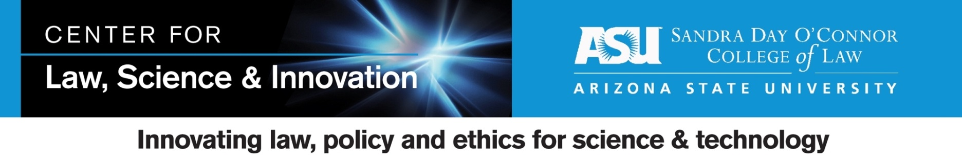

Utilization of Benzene Chromosomal Biomarkers by US Courts in Adjudicating Causation
Gary E. Marchant, Ph.D., J.D., MPP, Center for Law, Science & Innovation, Sandra Day O’Connor College of Law, ASU
Plaintiffs vs. Defendants
Genetic Biomarkers in Toxic Tort Litigation
Proponent | Successful | Unsuccessful | % Success
Plaintiff | 3 | 2 | 60.0%
Defendant | 5 | 3 | 62.5%
All | 8 | 5 | 61.5%
Genetic biomarkers having growing potential use in toxic tort cases
Relevant biomarkers:
● Chromosomal aberrations,
● Mutational spectra
● DNA adducts
● Susceptibility variants
● Gene expression patterns
Potential applications:
● Exposure analysis
● Causation (general and specific)
● Duty
● Damages
● Latent injury claims (increased risk, medical monitoring, fear of cancer)
Judges vs. Juries
Decider | Successful | Unsuccessful | % Success
Judge | 4 | 5 | 44.4%
Jury | 4 | 0 | 100.5%
All | 8 | 5 | 61.5%
Study Objective and Methods
Objective:
Case study of use of genetic biomarkers in toxic tort cases: Chromosomal aberrations in cases involving benzene exposure
Methods and Data Set:
● Westlaw database search identifies 13 cases in which plaintiffs allege benzene caused leukemia (or leukemia-related disease) and in which plaintiff or defense expert(s) support causation opinion with claim that specific chromosomal aberration is characteristic of benzene exposure
Conclusions
• Judicial system producing inconsistent results with similar evidence
• Both plaintiffs and defendants use biomarkers in appropriate cases with mixed results
• Juries more favorable than judges

