Slide 1
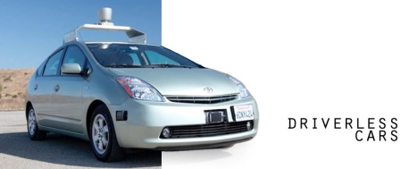


Old Laws, New Tricks:
Autonomous Vehicles and Drunk Driving
Katherine Hanna, J.D. Candidate 2015, Arizona State University
Question
How do current DUI laws apply to Level 3 autonomous vehicles?
Dilemma
Different states have different DUI standards.
Answer
Depends on the state! The California operator probably would not get a DUI while the Nevada operator probably would. Clear rules for autonomous vehicles that balance safety and fairness must be created before they go to market.
California | Nevada
“Driving” under the influence. | “Driving” or “actual physical control.”
Requires driver to control the movement of the vehicle. Police must witness the action. Based on action, not potential for action | Does not require vehicle to be in motion. Police do not have to witness the action. Potential for action is grounds for arrest.
Levels of Automation
0-1: No adaptive technology – Driver in control at all times
2: Adaptive Cruise Control - Only functions in certain situations.
3: Semi-Autonomous – Functions autonomously in over 90% of situations.
4: Fully Autonomous – Driver never has to take control.
References
http://www.nhtsa.gov/About+NHTSA/Press+Releases/U.S.+Department+of+Transportation+Releases+Policy+on+Automated+Vehicle+Development
CA VC § 23152
NV NRS § 484.013

